Slide 1
Alumni Leadership Assembly
Jill S. Walton
Vice President for Development and Alumni Relations

Slide 8
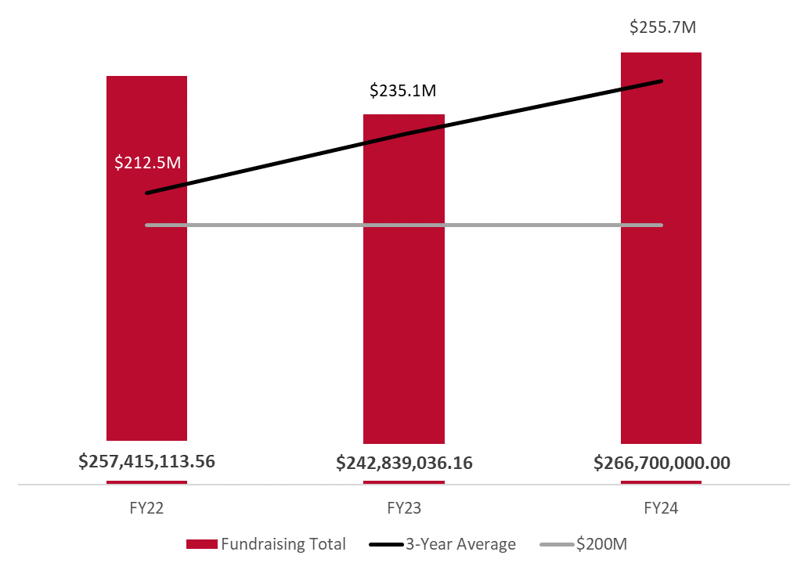
FY24 Fundraising Update: 3YRA
Notes:
Our great start to FY24 means that we are now trending toward over $255M for the year, which would bring our 3-year rolling average to $266.7M

Slide 9
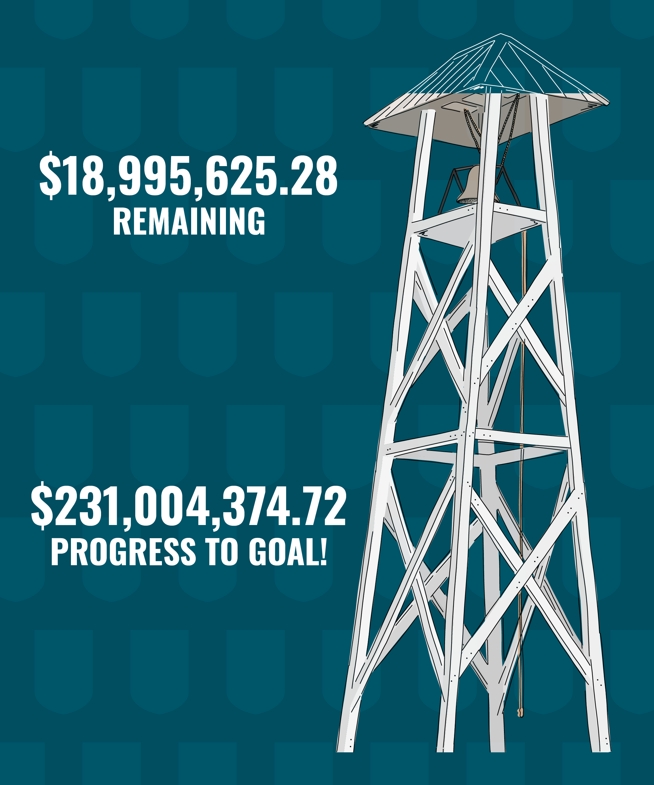
FY 24
Fundraising Update

Slide 11
Notes:
You may have heard the historic news that UGA was just approved to establish a new independent School of Medicine in Athens.
“The University of Georgia School of Medicine” … That has a nice ring to it!
Guys, this is a big deal - not only for UGA but for the people of the state of Georgia and our region of the country!
We have a critical need for more physicians in this state and this area of the country.
Currently, Georgia ranks 40th in physician to population ratio in the US.
This is an opportunity for us to serve our state and expand our impact across Georgia.
Our goal will be to attract the best medical students — as well as the best professors and the best researchers in order to produce more physicians to serve our state and region, including underserved populations and rural communities.
We are proud to partner with the state to ensure that together we are able to provide quality healthcare for all Georgians.
To say we are excited about this opportunity would be an understatement.

Slide 12
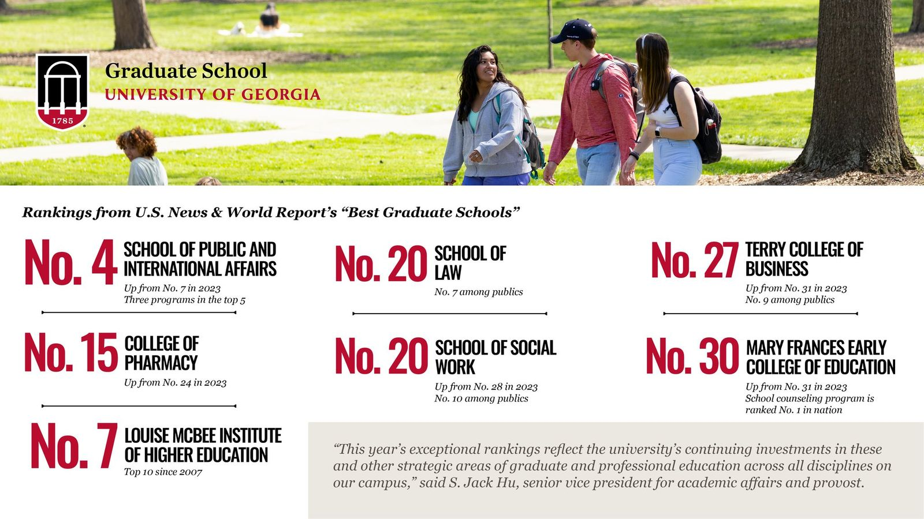
Notes:
The University of Georgia’s graduate and professional programs are among the nation’s best, according to the 2024 edition of “Best Graduate Schools” from U.S. News and World Report.
UGA’s School of Public and International Affairs ranked fourth overall, up three places from 2023. Three programs in the top 5: leadership (No. 2), public finance (No. 3) and local government management (No. 5). Among public institutions, the school is tied for second in the nation.
The College of Pharmacy jumped to No. 15 in the nation, up nine spots from its most recent ranking.
The Terry College of Business advanced to No. 27, up four places from 2023. Terry is No. 9 among public business schools, and Financial Times recently rated the University of Georgia’s full-time MBA the No. 1 value for the money worldwide.
The Mary Frances Early College of Education moved up one spot from last year to No. 30, and several of its programs ranked in the top 10. Notably, the school counseling program ranked No. 1 in the nation, curriculum and instruction #8, elementary teacher education #10 and secondary teacher education #10.
The higher education administration program in UGA’s Louise McBee Institute of Higher Education ranked No. 7 in the nation, continuing a run of top 10 rankings dating back to 2007.

Slide 13
What’s Next?

Slide 14
GROW
GIVE
GUIDE
your connection
your passion
your community
Notes:
We love G’s, right? So here are three G’s that sum up the journey we want our alumni to take.
We want them to grow their connection with UGA
We want them to give of their passion or give to their passion at UGA
And through their strengthened connections and their deep commitment, we want them to become guides for their communities and networks—showing them how UGA can advance their specific goals and our collective future.

Slide 15
GO DAWGS!

