Slide 1
Active Learning Initiative
Leah Carmichael, Director of Active Learning

Slide 2

Outline
What is active learning?
What we are doing at UGA?
What do you need from our office to support your engagement with active learning?

Slide 3
ACTIVE LEARNING 101

Slide 4





Passive Learning
In-Class
Out of Class

Slide 5



Why I Decided to Try Active Learning…
30% of information is lost by the end of the class
80% of information is lost after the semester
Universal Jurisdiction
Montevideo Convention
Jus in bello
50% of information is lost after one month
The Caroline Affair
General Principles
Applicants
Outer Space Law
Subsidiary Sources
Respondents
Treaties
Corfu Channel
Customary Law
Intl Humanitarian Law
Jus Cogens
Rome Statute
uti possidetis
Intl Court of Justice
The Refugee Convention
Disputes in the South China Sea
European Union
jus cogens
Amicus Briefs
Dispute
Resolution Mechanisms
Permanent
Court of
Arbitration
Antarctic Treaty
Partition Plan
United Nations Charter
Memorials
nonrefoulement
Notes:
References
Deslauriers, L., Schelew, E., & Wieman, C. (2011). Improved learning in a large-enrollment physics class. science, 332(6031), 862-864.
https://www.science.org/doi/full/10.1126/science.1201783?casa_token=re2zx-u0NzUAAAAA:aY1JTc5uFI5DTh3veb0kWe8yLaLuJ26SWnn6KX0o34RxWL1JrzRlX1rJ_yU8c8HYzVi0FuxuRciUX6__
Savoy, A., Proctor, R. W., & Salvendy, G. (2009). Information retention from PowerPoint™ and traditional lectures. Computers & Education, 52(4), 858-867. https://www.sciencedirect.com/science/article/pii/S0360131508002017?casa_token=onwU_rFwscwAAAAA:IoVAqNrj_-3Anw9vrAXiiHfDBmQNJLt4hJvNrviBnEsko6BIld0rvhAzyH35g3etUR48ZhDFo3Zv
Gooblar, D. (2019). Do students really learn nothing from a lecture. The Chronicle of Higher Education. https://www.chronicle.com/article/do-students-really-learn-nothing-from-a-lecture/?cid=gen_sign_in
Varao-Sousa TL, Kingstone A. Memory for Lectures: How Lecture Format Impacts the Learning Experience. PLoS One. 2015 Nov 11;10(11) https://www.ncbi.nlm.nih.gov/pmc/articles/PMC4641615/

Slide 6



Passive Learning
Why it doesn’t work...
Blah blah blah
Blah blah blah
New Information
New Information
Blah blah blah
Blah blah blah
New Information
New Information
Blah blah blah
New Information
Blah blah blah
New Information
?

Slide 7


Active Learning
Doolittle, P., Wojdak, K., & Walters, A. (2023). Defining Active Learning: A Restricted Systemic Review. Teaching and Learning Inquiry, 11 (here)
What is Active Learning?
"To expand and reify active learning in higher education, various colleges and universities have included active learning in their guiding principles or academic structure. For example, the University of Georgia created an Office of Active Learning … and has included active learning as the center of their accreditation Quality Assessment Plan."
https://www.chronicle.com/article/can-this-university-change-its-teaching-culture?sra=true

Slide 8
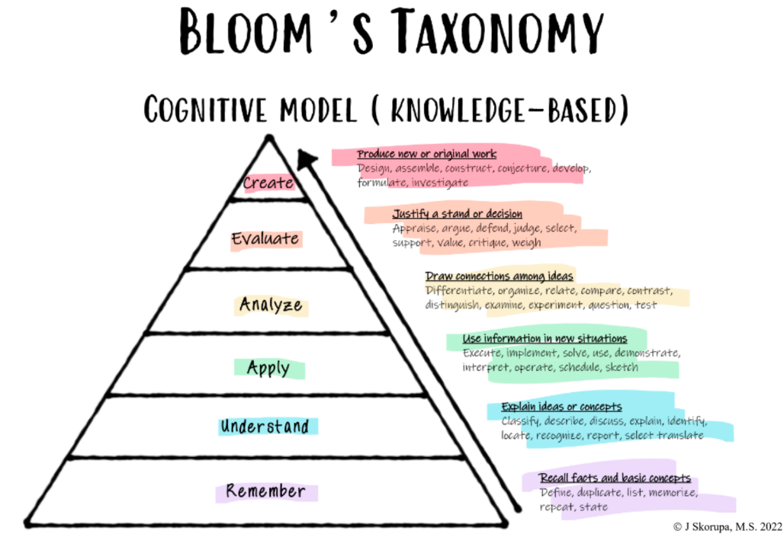

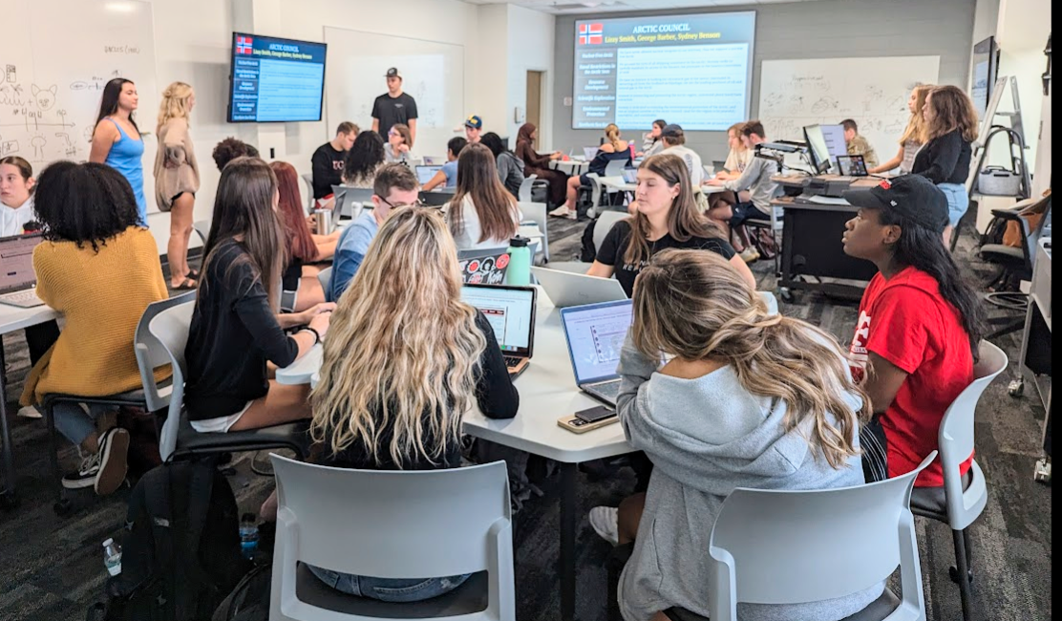


Active Learning
Active Learning is a
student-centered approach to teaching and learning in which students:
Fully engage in the content and skill development (e.g., socially, actively, and/or cognitively)
Create new knowledge
Reflect on their learning (i.e. metacognitive learning opportunities)

Slide 9



Active Learning’s Impact
Lifelong Learning
CURIOSITY - INITIATIVE CONNECTIONS - REFLECTION
Increased Engagement
Kuusinen, C. M., Mittelstadt. M. L., & Jordan, A. 2017, Harackiewicz et al. 2016
Belonging
Harackiewicz et al. 2016; Hulleman et al. 2010; Eddy & Hogan 2014; Haak et al. 2011
Retention
Kuusinen, C. M., Mittelstadt. M. L., & Jordan, A. 2017, Harackiewicz et al. 2016
Self Efficacy
Harlow 2021; Strange et al., 2001
Academic Performance
Reinholz 2015; Freeman et al. 2014; Gingerich et al. 2014; Baepler et al. 2014

Slide 10
ACTIVE LEARNING INITIATIVE @ UGA

Slide 11



UGA’s Active Learning Initiative
INSTRUCTOR DEVELOPMENT INITIATIVES
STUDENT SUPPORT INITIATIVES
CLASSROOM ENHANCEMENTS
Provide resources, support, and training to promote active learning in undergraduate classrooms
Prepare students to be successful active learner both inside and outside the classroom
Transform learning spaces for active learning through classroom & infrastructure updates
www.activelearning.uga.edu

Slide 12





Instructor Development
AL Research
Change Grants
OBJECTIVE
AL Certification Pathways
To provide resources, support, and training to promote active learning in undergraduate classrooms
Active Learning Techniques
Introduction to Active Learning Sessions
Active Learning at New Faculty Orientation
Active Learning Description in Hiring Documents

Slide 13

Student Engagement
Active Learning Ambassadors
OBJECTIVE
Peer Learning Assistants
To raise students’ awareness of the techniques and benefits of active learning and support their engagement inside and outside the classroom.
UNIV 1202 & 1204 Courses
Student Affairs Opportunities
New Student & Family Orientation
Active Learning as Recruitment Tool (Admissions)

Slide 14

Classroom Enhancements
OBJECTIVE
Model Classrooms
To transform learning spaces for active learning through classroom and infrastructure updates.
ALSI Alumni Scheduling
Classroom Enhancement Priorities
Active Learning Classrooms Inventoried
Active Learning Classroom Attributes Determined

Slide 15

Active Learning
https://www.chronicle.com/article/can-this-university-change-its-teaching-culture?sra=true

Slide 16
Active Learning
While all such plans must lay out a path for improving student outcomes, teaching experts at other universities say that Georgia’s focus on teaching culture is ambitious and unusual — especially for an R1 university…
If Georgia’s project is successful, it would demonstrate that a college can, in fact, encourage professors to embrace more-effective teaching approaches, provided the institution is willing to invest the necessary resources. And it could offer other colleges a playbook for doing the same.

Slide 17

Questions?

Slide 18
Thank you!

