Slide 1

Enrollment Management Update

Slide 2
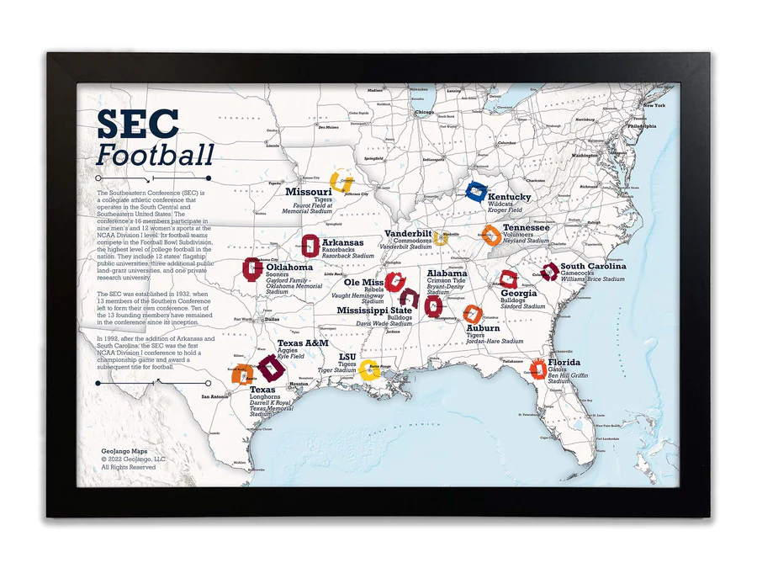
Best Universities in the SEC?

Slide 3
US. News Peer Rankings Survey
Annual Survey of Presidents, Provosts, and “Deans of Admissions” rate the academic quality of peer institutions with which they are familiar on a scale of 1 (marginal) to 5 (distinguished).
Alabama
Auburn University 5 4 3 2 1 Don’t Know
University of Alabama 5 4 3 2 1 Don’t Know
Mississippi
Mississippi State University 5 4 3 2 1 Don’t Know
University of Alabama 5 4 3 2 1 Don’t Know
Texas
Texas A&M University 5 4 3 2 1 Don’t Know
University of Texas 5 4 3 2 1 Don’t Know

Slide 4
US News Survey
Georgia National Universities
Augusta University 5 4 3 2 1 Don’t Know
Brenau University 5 4 3 2 1 Don’t Know
Clark Atlanta University 5 4 3 2 1 Don’t Know
Emory University 5 4 3 2 1 Don’t Know
Georgia Institute of Technology 5 4 3 2 1 Don’t Know
Georgia Southern University 5 4 3 2 1 Don’t Know
Georgia State University 5 4 3 2 1 Don’t Know
Kennesaw State University 5 4 3 2 1 Don’t Know
Mercer University 5 4 3 2 1 Don’t Know
University of Georgia 5 4 3 2 1 Don’t Know
University of West Georgia 5 4 3 2 1 Don’t Know
Valdosta State University 5 4 3 2 1 Don’t Know

Slide 5
US News Survey Peer Assessment
Georgia National University 2024 Peer Assessment
Georgia Institute of Technology 4.3
Emory University 4.2
University of Georgia 3.7
Georgia State University 3.0
Mercer University 2.6
Georgia Southern University 2.5
Kennesaw State University 2.5
Clark Atlanta University 2.3
Augusta University 2.2
Valdosta State University 2.2
University of West Georgia 2.1
Brenau University 1.8

Slide 6
US. News Peer Rankings Survey
SEC University Avg. Peer Score
Vanderbilt 4.3
Texas 4.2
Florida 3.8
Georgia 3.7
Texas A&M 3.7
Auburn 3.3
Missouri 3.3
Tennessee 3.3
Alabama 3.2
Kentucky 3.2
Oklahoma 3.2
South Carolina 3.2
Arkansas 3.1
Ole Miss 3.0
LSU 2.9
Miss St 2.7
Annual Survey of Presidents, Provosts, and “Deans of Admissions” rate the academic quality of peer institutions.
The survey makes up 20% of the total rankings.
Of the 4,734 academics who were sent the survey, 1,458 responded (30.8 response rate).
Best undergraduate program rankings are based solely on the judgements of deans and senior faculty members at peer institutions who participated in a peer assessment survey.

Slide 7
Relative Market Position (Draw Rate)
Georgia
Admit = 43%
Yield = 38%
38%/43% = 0.9
Auburn
Admit = 44%
Yield = 27%
27%/44% = 0.6

Slide 8
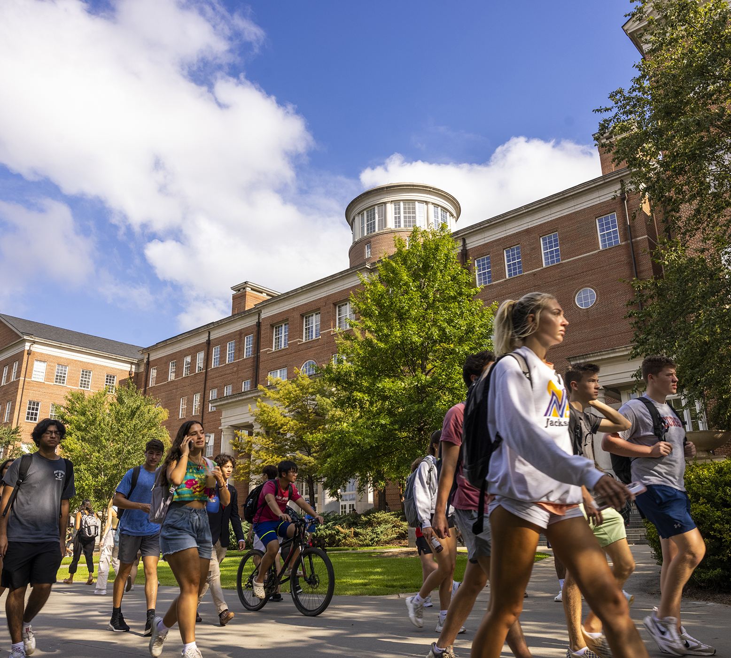
Competitors

Slide 9
Overall Competitors (2018-2022)
Georgia Tech
Florida
North Carolina
Clemson
South Carolina
Virginia
Florida State
Texas
Alabama
Auburn

Slide 10
Competitors for Georgia Residents
Georgia Tech (1,429)
Georgia State (109)
Emory
Mercer
Kennesaw State
Auburn
Vanderbilt
Georgia Southern
Augusta
Clemson

Slide 11
Non-Resident Competitors
Florida
North Carolina
Clemson
South Carolina
Texas
Florida State
Virginia
North Carolina State
Alabama
Michigan
27. Georgia Tech (we don’t compete with Georgia Tech for non residents)

Slide 12
Admissions Funnel

Slide 13
Test Scores

Slide 14
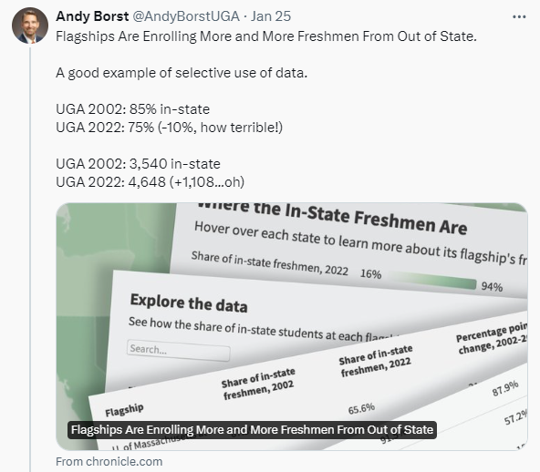

Focus on Georgia Residents

Slide 15
Every 1% increase in the proportion of non-residents in the freshman class results in an additional $1.2 million in additional tuition revenue in the first year and an additional $4.7 million over four years.
Residency mix
$19 Million

Slide 16

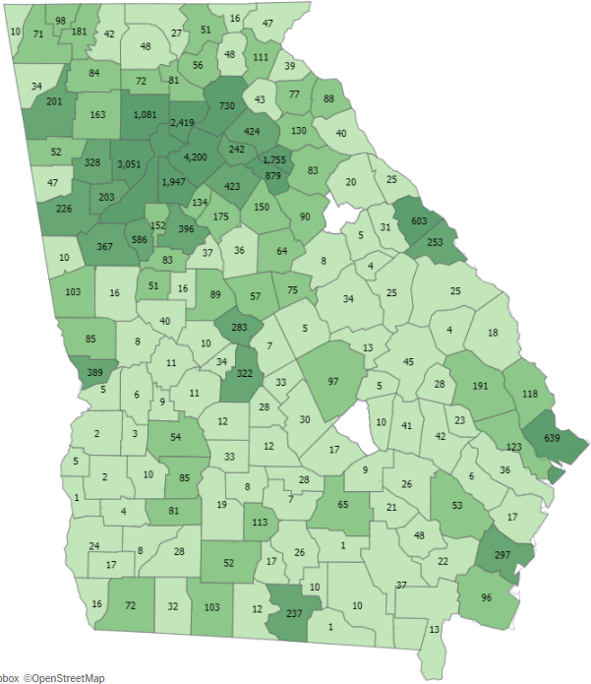

Record enrollment of Georgia residents
Georgia residents represent 84% of undergraduate enrollment
Increase in enrolled Georgia residents over the last decade.
+11%
UGA’s record total enrollment is due to enrolling more Georgia residents than ever before, supplemented by highly talented non-residents.

Slide 17
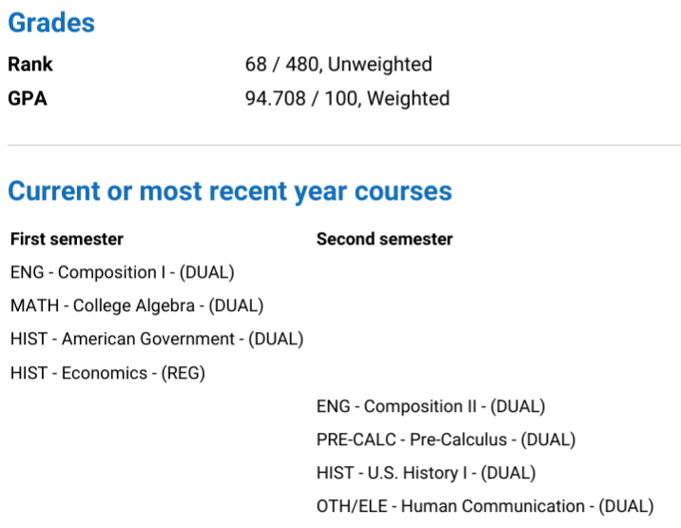
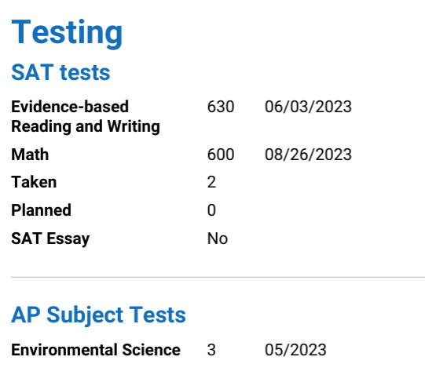
Academic Review

Slide 18
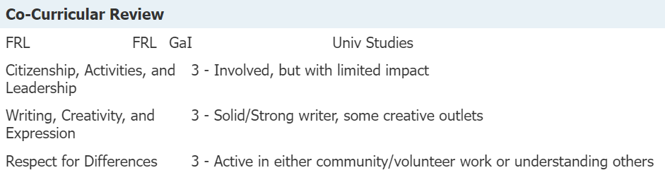
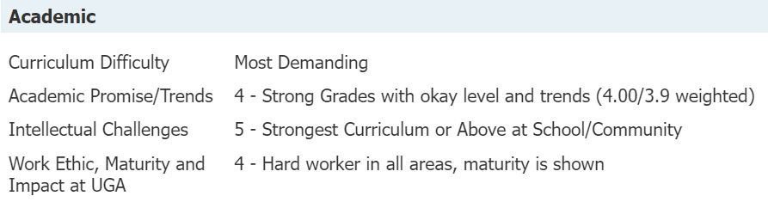
Read Score

Slide 19
Georgia
Commitment Scholarship

Slide 20
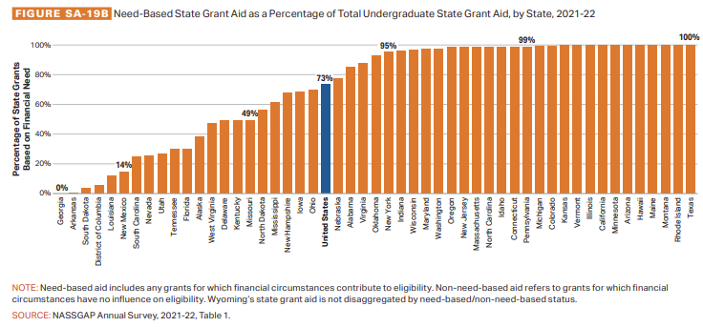
Georgia is one of two states that does not offer Need-Based Financial Aid
State Grant Emphasis
https://research.collegeboard.org/media/pdf/Trends%20Report%202023.pdf

Slide 21
State Income Distribution
Source: https://data.census.gov/table?q=DP03&g=040XX00US13

Slide 22
Income Distribution vs Undergrad Enrollment

Slide 23
Georgia Resident Financial Aid Package by AGI
Cost – Financial Need =
(-$8,164)
(-$76,982)

Slide 24
Georgia Resident Lowest Income Aid Award

Slide 25
Enrollment Planning

Slide 26

Can you name this Dawg?

Slide 27
Enrollment Management Strategy Group
Our charge: Develop a five-year (2024-2028) EM strategy that includes projections for:
  Overall enrollment
  Revenue
  Student-to-Faculty Ratio
Addressing the following issues:
  First-year & transfer enrollment targets
  Retention & Completion rates
  Graduate education participation among current students (i.e. Double Dawgs)
  Opportunities to increase total grad and professional enrollment
  Funding model to develop, implement, and support new programs in high demand areas.
Provide an interim report by May 2024 & final report by August 2024.

Slide 28
Enrollment growth is limited by physical space, not necessarily by market demand. The overall strategy is grow in high demand areas other than the freshmen undergraduate cohort.
Enrollment Strategy
Planned Annual Average Growth
Undergraduate +1.0%
Professional +2.0%
Graduate/Online +2.5%
Total +1.5%
Notes:
Enrollment Context
The University of Georgia’s ability to grow enrollment is limited by physical limitations in Athens rather than by limited market demand. This strategy recommends moderating on-campus undergraduate enrollment to allow for on-campus to catch up with market demand. The overall growth is projected to be approximately 4,000 new students enrolled at UGA, however, less than 400 new students per year would be physically located on the Athens campus. Expanding online graduate programs in high demand areas at scale will allow UGA’s enrollment to support the mission of the university by serving Georgians who are currently taking online programs from institutions primarily located outside of the state.

Slide 29
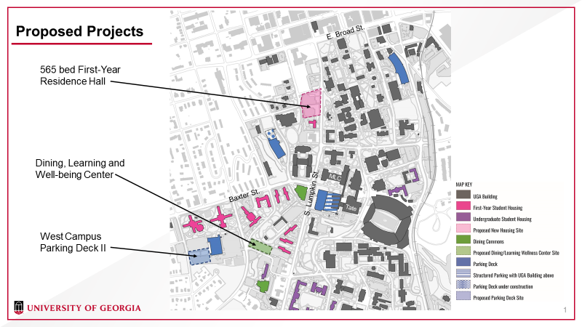
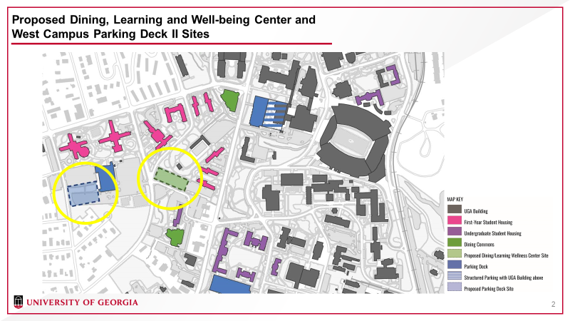
Housing & parking are the two primary limitations to growing on-campus enrollment. We need to let capacity catch up with demand.
Planned infrastructure
The new 565-bed residence hall will create more capacity and allow UGA to renovate older residence hall spaces, rather than grow the freshmen class.

Slide 30
We plan to maintain the size of our first-year cohort to be approximately 6,150. We intend to reduce the variance in the size of the first-year cohort down from 2% (+/-100) to 1% (+/-50)
New Freshmen
provost.uga.edu

Slide 31
Transfers represent 1 in 4 of all undergraduates at UGA. There is potential to increase the number of transfer students on campus within the bounds of campus resources.
New Transfer

Slide 32
Moderating undergraduate enrollment growth will temper net tuition revenue growth. Additional funds to expand the research enterprise of the university will need to come from more sources than just growth in undergraduate tuition.
Net Tuition Revenue
+$6.5M
+$4.9M
+$12M
+$9.3M

Slide 33
Most aspirational & comparator peers have larger graduate enrollments. There is potential to grow graduate enrollment through new online programs and less reliance on tuition waivers.
Graduate Enrollment
+3.0% annual increase for 5 years will increase graduate/professional enrollment to ~12,000

Slide 34
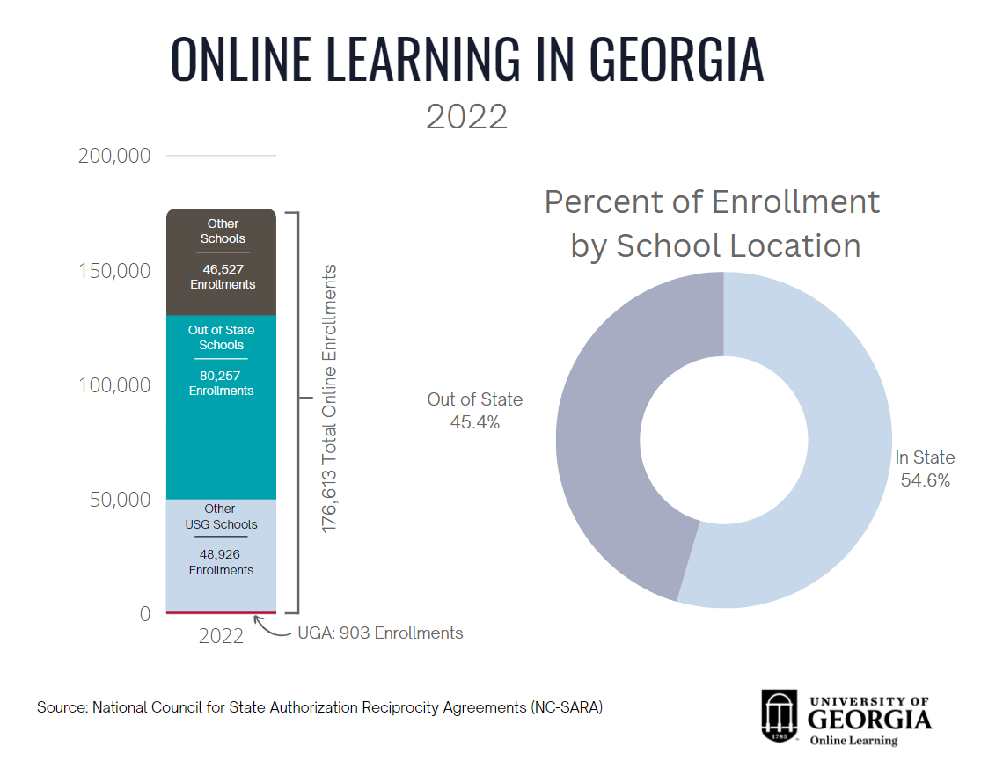
Online Enrollment
There is capacity to grow online graduate programs in high demand areas.
Source: NC-SARA

Slide 35
Projected Online Graduate Enrollment
 | 2023 | 2024 | 2025 | 2026 | 2027 | 2028
Existing Programs | 1,033 | 1,088 | 1,144 | 1,199 | 1,254 | 1,310
Public Health |  | 50 | 90 | 100 | 100 | 100
Civil Engineering |  | 20 | 55 | 70 | 80 | 90
Legal Studies |  | 10 | 20 | 20 | 20 | 20
Higher Education |  |  | 30 | 60 | 60 | 60
Accounting |  |  | 20 | 50 | 65 | 70
Mechanical Engineering |  |  |  | 20 | 55 | 70
Data Science |  |  |  | 35 | 70 | 70
Anticipated Program #1 |  |  |  |  | 30 | 50
Anticipated Program #2 |  |  |  |  | 30 | 50
Anticipated Program #3 |  |  |  |  |  | 30
Anticipated Program #4 |  |  |  |  |  | 30
New Program Subtotal |  | 80 | 215 | 355 | 510 | 640
Total Online | 1,033 | 1,168 | 1,359 | 1,554 | 1,764 | 1,950

Slide 36
Enrollment Strategy
Emphasis on letting capacity catch up with market demand.
Maintain the size of the first-year class
Grow new transfer enrollment in targeted programs with capacity.
Grow graduate enrollment in high-demand online programs.

Slide 37


Questions

