Slide 1
Leading a Chapter 101
Ally Howard
Associate Director of Alumni Chapters
Alumni Relations

Slide 2
What does it mean to be a Chapter Leader?
A great leader posses a clear vision, is courageous, has integrity, honesty, humility, and clear focus. Great leaders help fellow board members reach their goals and take pride in the accomplishments of those along the way

Slide 3
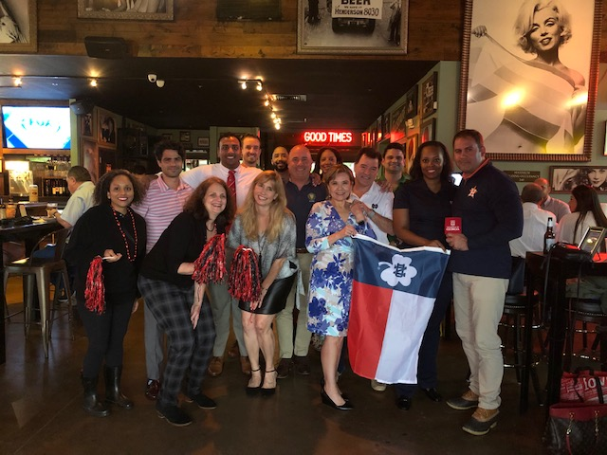
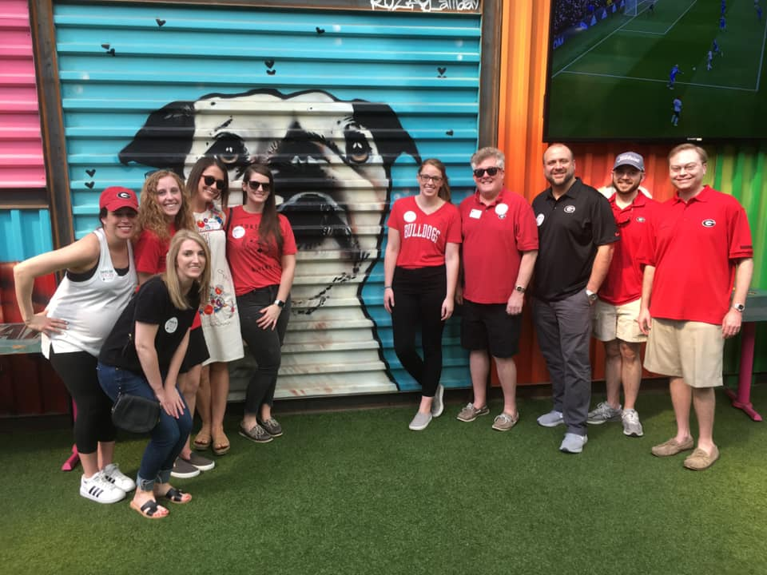
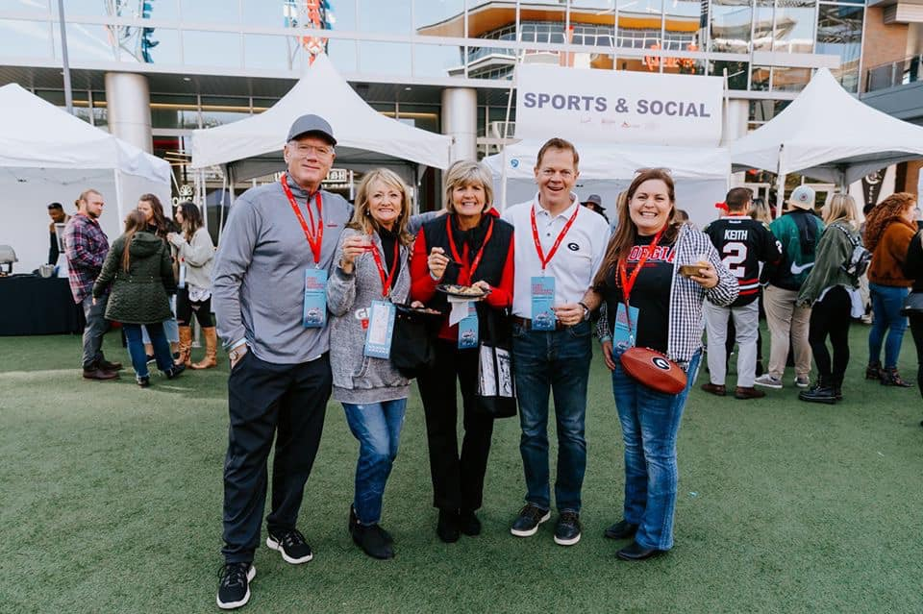
Event Planning
Plan quarterly Chapter Board meetings to plan events for the next few months
Important factors to consider: Event Categories, Audience, Feasibility, and Community Engagement

Slide 4
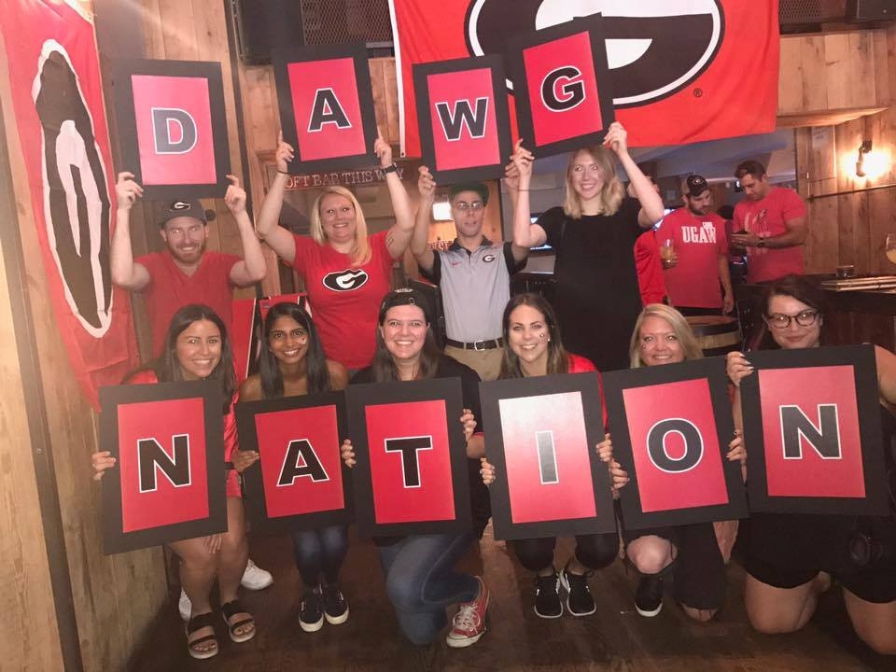
Who/What/When/Where/Why/How?
Who?
Who are you trying to attract?
What?
What events should my chapter have this year?
When?
When should these events happen?
Where?
Where should these events happen?
Why?
What are the goals for this event?
How?
How do I make these events happen?
Notes:
Who
What
When
When can people actually make it to events? – It is important to have events at a variety of times (weekends, weekdays, before work, after work, etc.)
Seasonal considerations – If you are planning an outdoor event consider weather and driving conditions.
What other events may be happening in your area at the same time? Is there something happening in your community that you can take advantage of, or that will prohibit people from attending events?
What is happening at UGA – It is always good to consider what UGA is celebrating and how your chapter can participate
Where
Is there a Bulldog owned business in your area – Do you or any other chapter leaders know of a UGA alumni owned bar, restaurant, or venue that could work for the event your planning? It is always fun to support fellow Dawgs!
Should the venue be free – In other cases, such as game watching parties and Bulldogs After Business Hours, you should always find businesses that will not charge you to use the space or require a minimum purchase.
Does the venue cost money – In some cases, paying for an event space is inevitable, when this is the case inquire as to whether the venue will direct bill the Alumni Association so you don’t have to spend the money up front – this is always preferable.
Why -As your leadership team plans events, remember to let the follow questions guide your process.
Who are you trying to attract?
What is purpose of your event? i.e. fun, networking, volunteerism, etc…
Will this event uphold the mission of UGA?
How
Stay with what works. If you have a great event, make it an annual event people can look forward to each year or consider a monthly series.
Consistency is key. Try to avoid 1+ month(s) between events – keep the calendar fresh and engaging!
Participate in Nationwide Events. Ideally, every active chapter should have an event for their members to attend – that’s 3 events you can keep on your chapter’s calendar every year!
Keep an eye on the Chapter Leader Facebook group for ideas. If you love the brainstorming that happens at ALA, take a look at the Facebook group, points sheet, or Alumni Association event calendar to see what other chapters are doing!

Slide 5
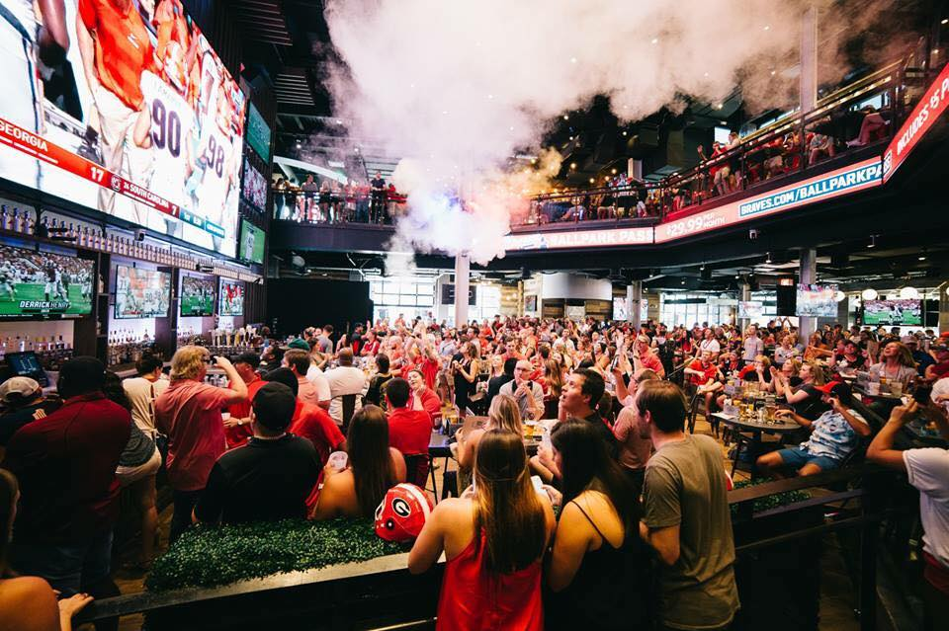
Event Categories
Alumni Connect
Academic Interest
Professional Development & Networking
Student Focused
Service
Donorship
Affinity
Notes:
Bullet one: chapter leader rolls off, moves, or has to step down
Exception: if someone approaches you about being on the board in a specific position determine if they are a good fit.

Slide 6
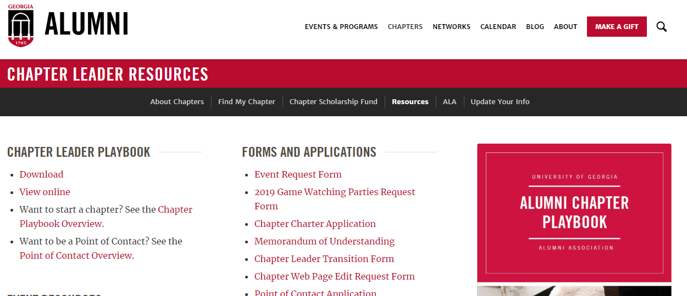
Event Request Form
The event request form is a simple online form that prompts you to enter the details of your event and allows UGA Alumni Association staff to support your event.
Filling out the event request form allows your staff contact to:
Send official UGA evites to your chapter area
Add the event to the chapter Web Page
Promote the event on the Alumni Association online master calendar
Send supplies to the chapter (sent to event contact within a week of the event)
Attend the event (when appropriate)
Provide further support
**Even if you do not need an e-vite, want a webpage, or need supplies, please always submit an event request form!**
Notes:
Bullet one: chapter leader rolls off, moves, or has to step down
Exception: if someone approaches you about being on the board in a specific position determine if they are a good fit.

Slide 7
Event Planning Timeline & Best Practices
12 weeks in advance
If the chapter needs Grant Funding, submit a Grant Funding Request Form (Grant funding to be covered in Part B!)
8 weeks in advance
Contact venues and vendors and send contracts to the Alumni Association
Events requiring direct payments from UGA should be shared with staff member
If event has a ticketing component, work with AA to work out details
Start promotion on social media with a save the date
6 weeks in advance
Submit Event Request Form (Go to www.alumni.uga.edu → chapters tab → chapter leader resources → forms and applications →Event Request Form)
Advertise the event on Social Media & through the Chapter Listserv
2 weeks in advance
Last opportunity to submit event request
Day of the Event
We ask that at least one Chapter Volunteer is present at every event to help host and represent the Chapter and UGA Alumni Association
After the event make sure to send us the sign in sheet’s and share photos on social media & with Alumni Association staff
Notes:
Planning events on the first time, even if it isn’t successful keep trying and do more! Success looks different feed back

Slide 8
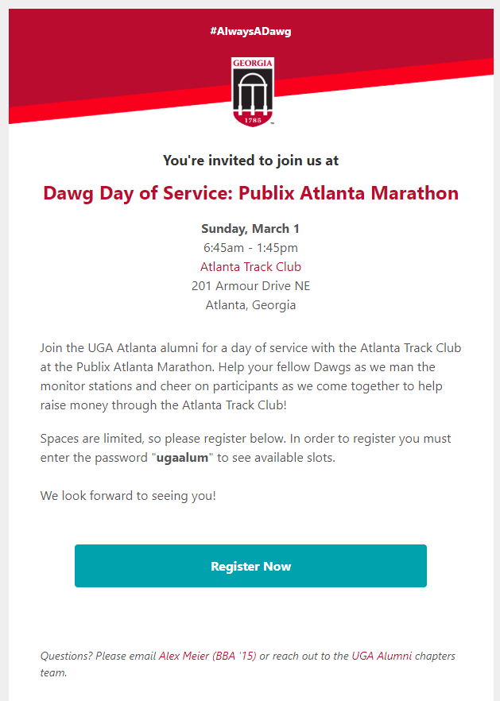
Evites
Evites are electronic invitations that are sent to UGA alumni who have indicated they live in the area of the local chapter
When submitting content for evites, please make sure to include as much information & language as possible
Evites can go out on weekdays only
Evites can go out twice before any given event if there is enough time
If you choose to have two evites sent out, the second evite can go out no earlier than seven days after the original evite
The dates you select for evites to go out are subject to change
Chapter leaders are always able to review their evite and provide feedback
Communications staff will always provide a final round of proofing and editing before evite is sent
Notes:
Bullet one: chapter leader rolls off, moves, or has to step down
Exception: if someone approaches you about being on the board in a specific position determine if they are a good fit.

Slide 9
Registrations
When NOT to have registrations
When to have registrations
The event has a capacity
The event requires payment by attendee
The event requires demographic or personal information (i.e. shirt size, food allergies, etc.)
You need an exact number of attendees before hand
You need to follow up with attendees with additional details
The event has a capacity
The event requires payment by attendee
The event requires demographic or personal information (i.e. shirt size, food allergies, etc.)
You need an exact number of attendees before hand
You need to follow up with attendees with additional details
Notes:
Bullet one: chapter leader rolls off, moves, or has to step down
Exception: if someone approaches you about being on the board in a specific position determine if they are a good fit.

Slide 10
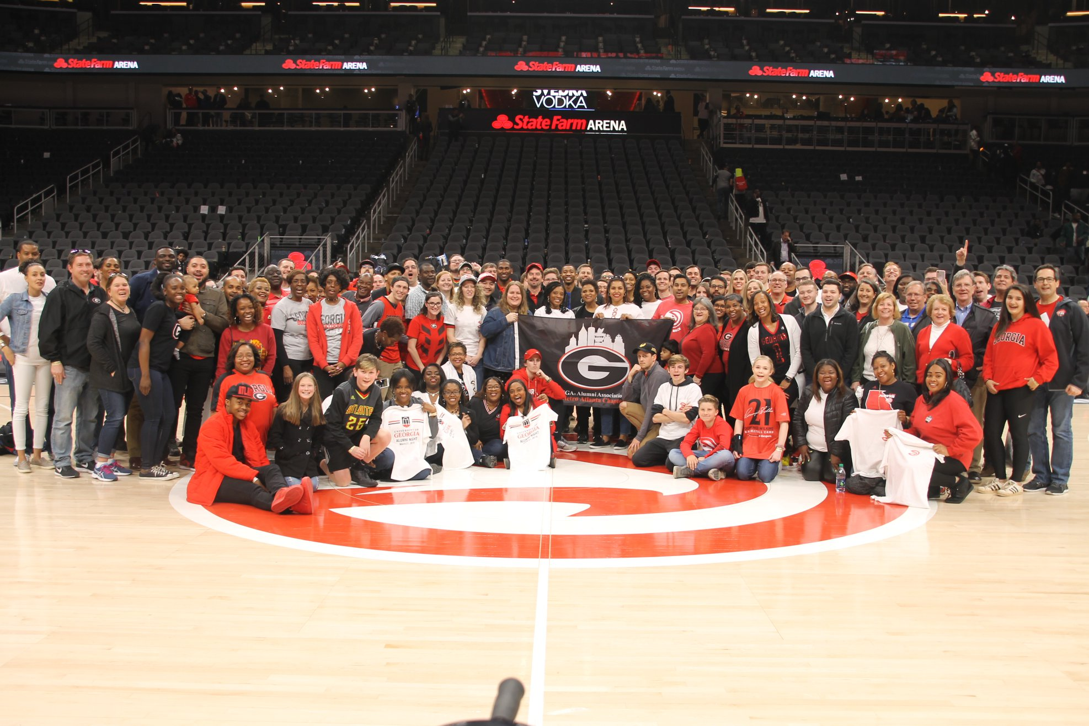
Ticketed Events Policy
Ticketed Events Policy
If it is possible for chapter members to order tickets individually through a venue-owned website, this option must be utilized
Chapter leaders must ask the venue to submit a W-9 if group tickets are being purchased
Alumni Association staff will work with you to purchase pre-ordered group tickets and determine the quantity
To determine the right number of tickets, base your estimate on previous event attendance for similar programs.
Notes:
Sarah

Slide 11
Intentional Event Planning
Pre-Event:
Establish event goals and acknowledge your target audience. Submit your event request form at least 6 weeks in advance to allow time to promote the event.
Opener:
Greet everyone who attends with a warm welcome and facilitate conversation between attendees.
During the Event:
Establish meaningful, lasting connections – make sure everyone who attends talks to at least one board member!
Closing:
Thank everyone for coming and provide every attendee with an action item as they leave. Like us on Facebook, come to our upcoming event, etc.
Post-Event:
Follow-up with attendees so they can stay connected with the chapter. Collect feedback about the event and seek ideas for future programming.
Notes:
Sarah

Slide 12
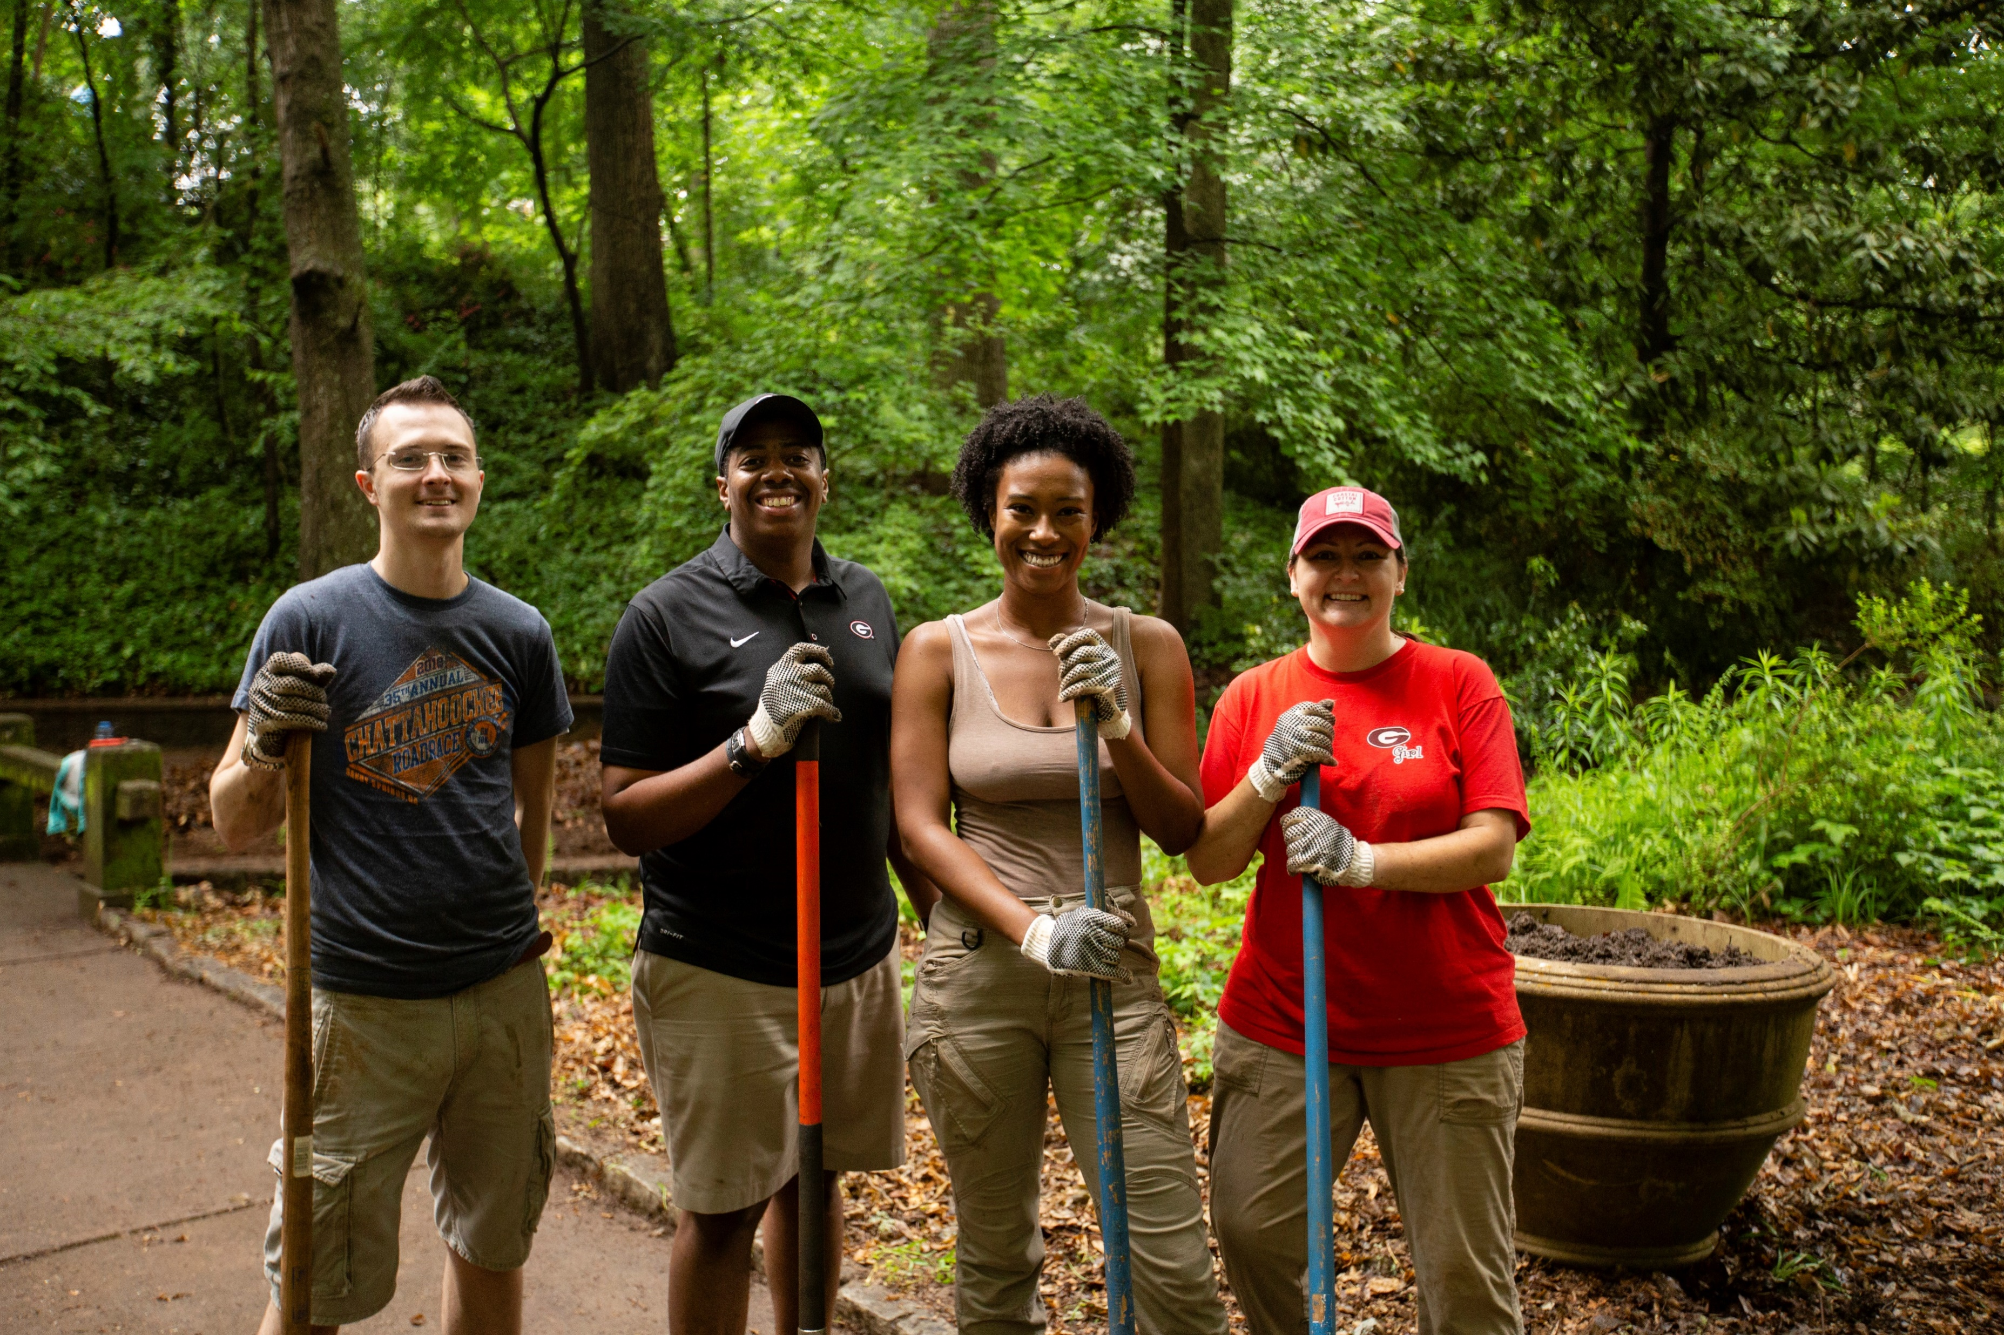
Nationwide Event Changes
Nationwide Events are a great way to easily plan several events throughout the year that will count toward required events for Arch chapters.
Fall: Game Watching Parties - Chapters gather to watch any or all of the UGA football games.
Summer: Freshman Send-Offs
Summer: Welcome to the City – Nationwide Bulldogs After Business Hours event to welcome young alumni to their city
Spring: Dawg Day of Service – Each chapter chooses a service opportunity in their area
Notes:
Bullet one: chapter leader rolls off, moves, or has to step down
Exception: if someone approaches you about being on the board in a specific position determine if they are a good fit.

Slide 13
Double Dawg Dare Program
January: Founders Week Celebration
February: UGA Black Alumni Affinity Programming
March: UGA Alumni Chapters Scholarship Percentage Night
April: G Day Game Watching Party
May: Dawg Day of Service*
June: Women of UGA Alumni Affinity Programming
July: Active Military or Veteran service Event
August: Welcome to the City*
September: Back to School Academic Event
October: UGA Young Alumni Affinity Programming
November: Give Back Game Watching Party
December: Chapter Holiday Party
Notes:
The Alumni Association double-dawg-dares you to host the following events in your chapter area! In an effort to promote chapter events in each of the seven event categories and engage a broad range of alumni, we encourage chapters to host the following Double Dawg Dare events. These events will be worth double points for Arch chapters when hosted in the designated month. These are not meant to replace any existing programs; this is simply meant to serve as inspiration!

Slide 14
Questions?

