Slide 1
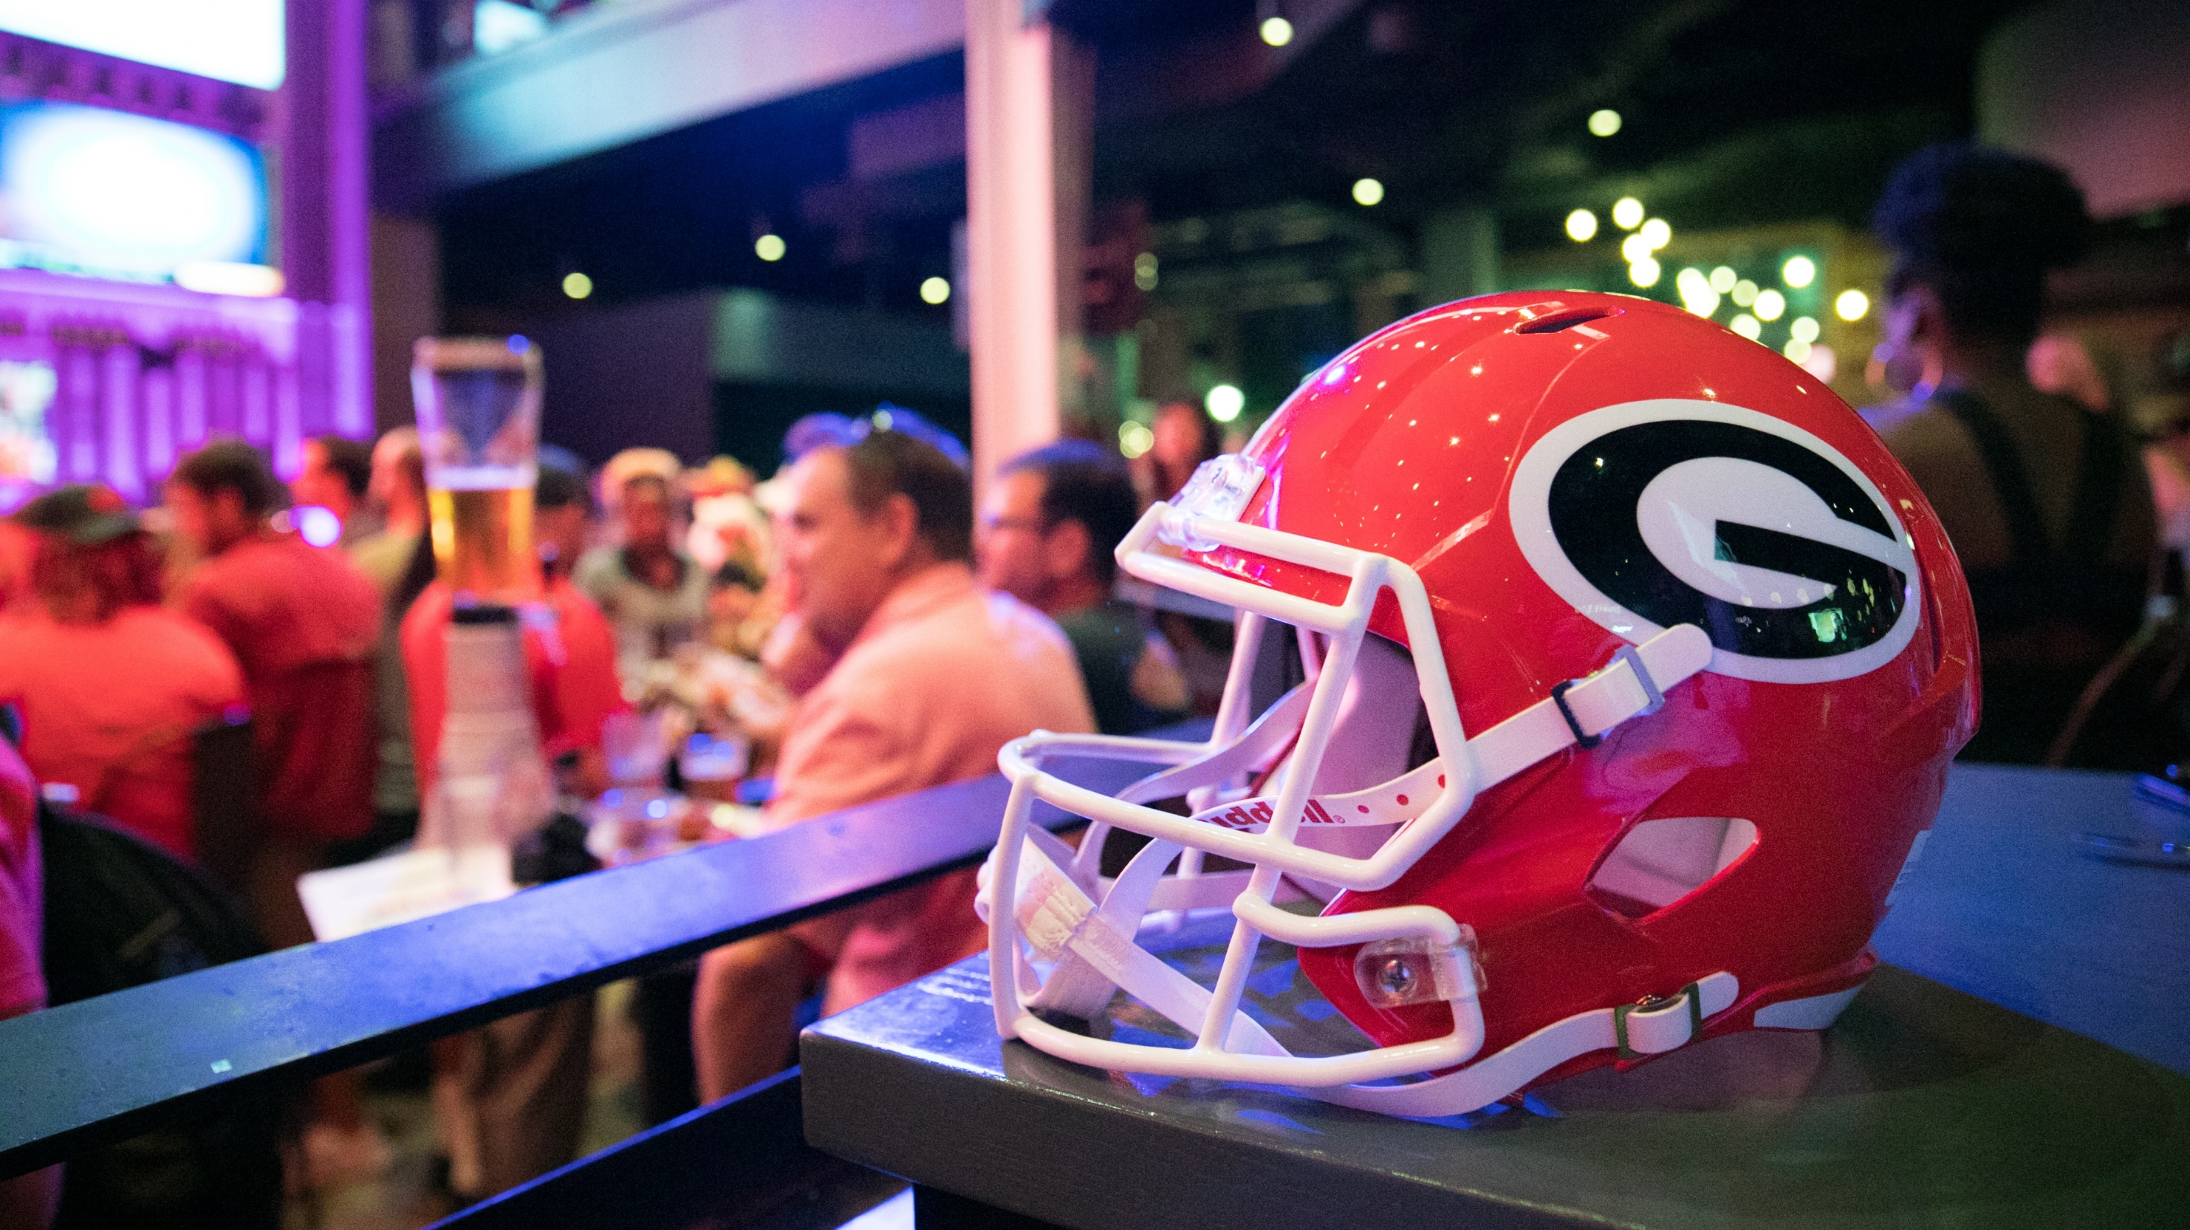
Game Watching Parties
Diana Fontaine

Slide 2
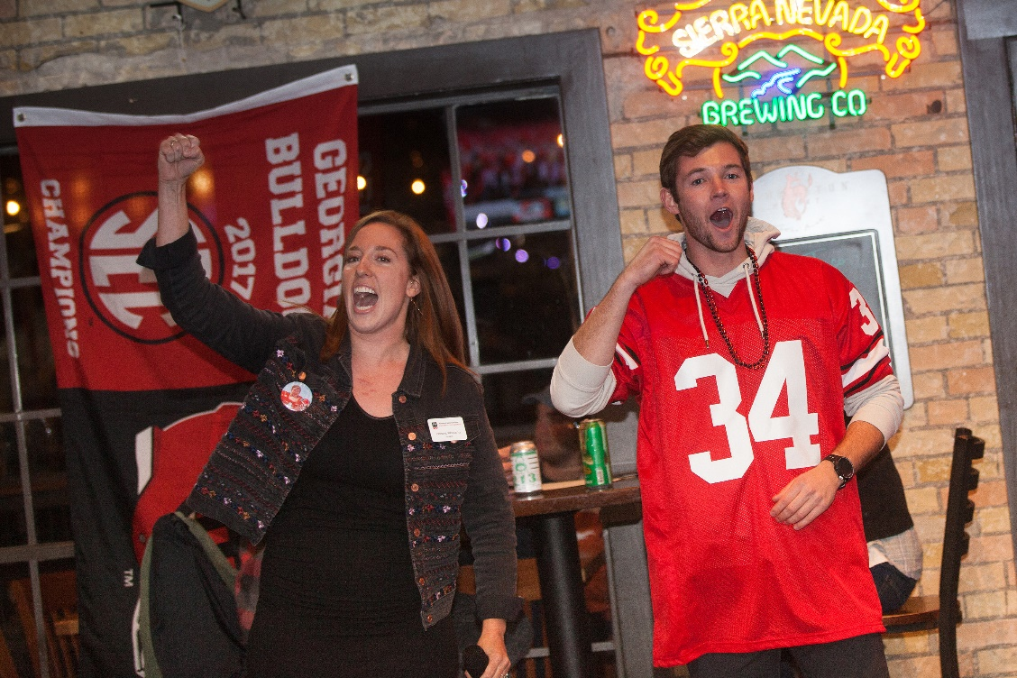
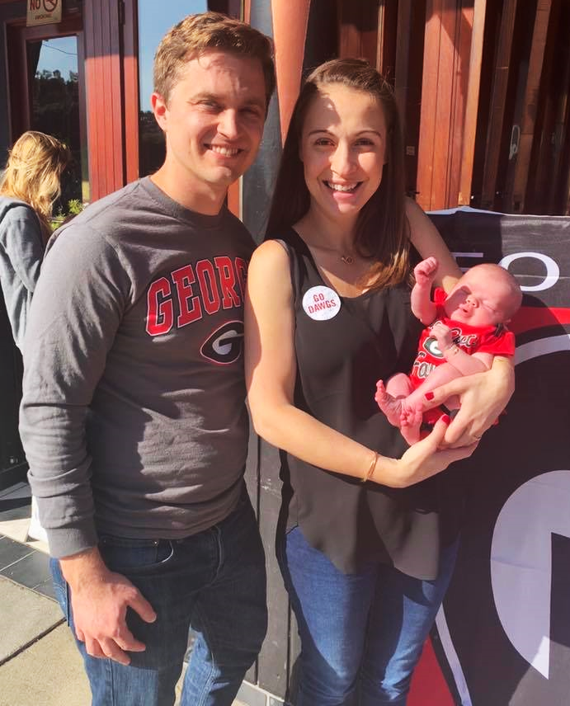
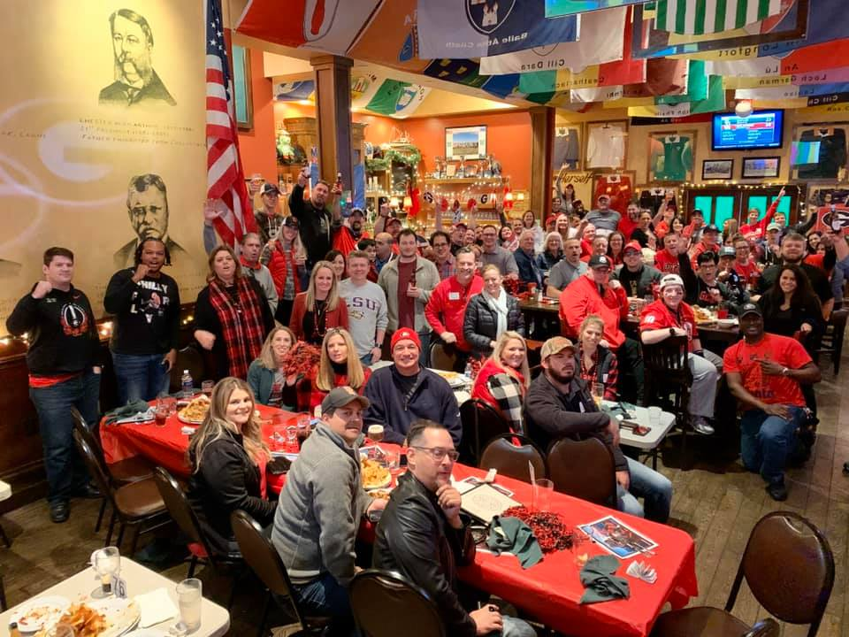
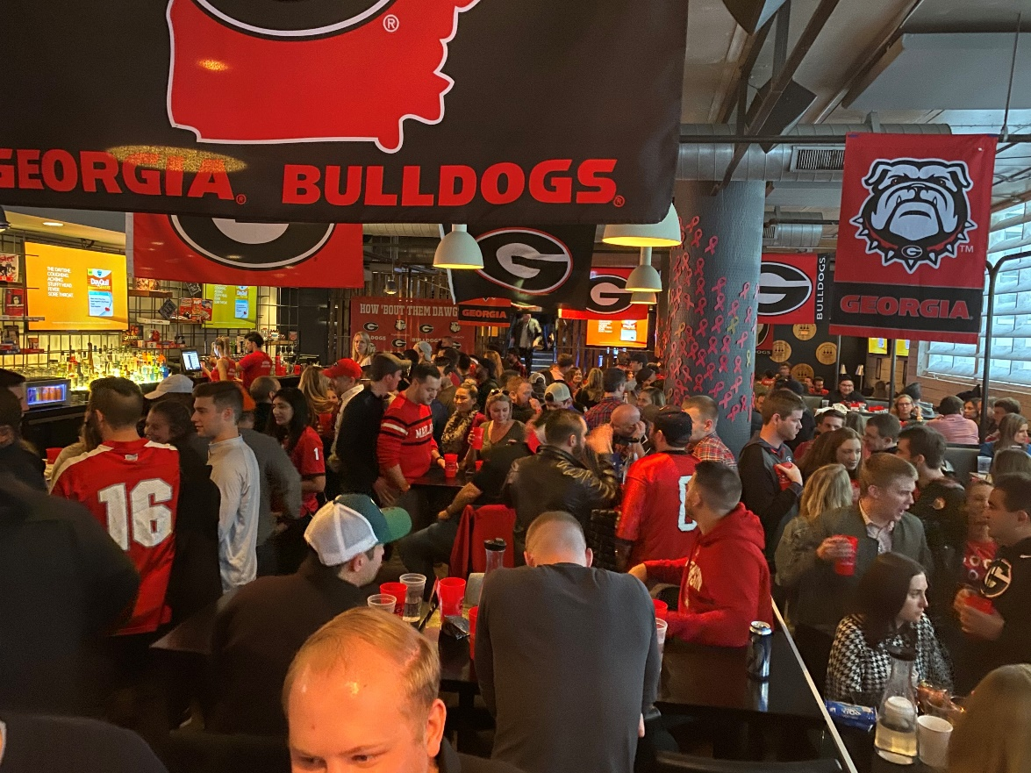
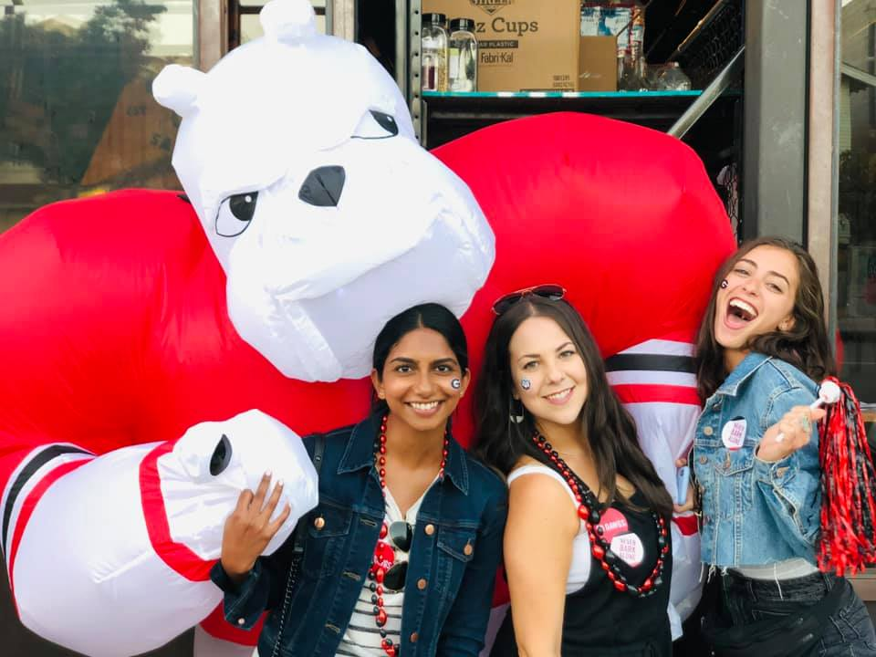
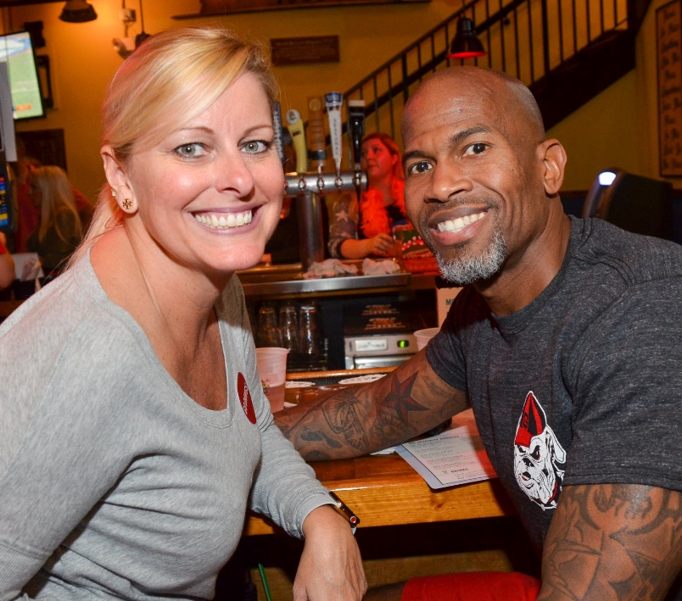
Alumni.uga.edu

Slide 3
Alumni.uga.edu

Slide 4
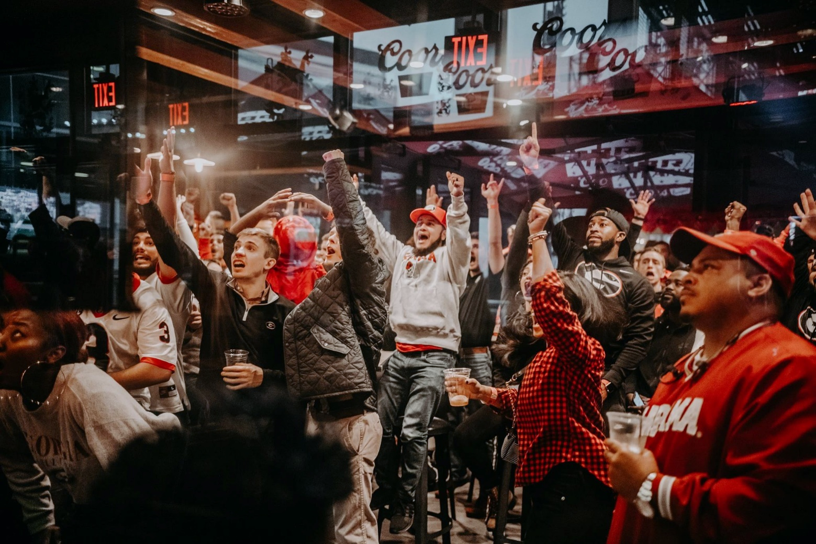
What makes a great Game Watching Party?
Best practices:
Venue
Communications
Event Experience
Chapter Leader Panel
Austin
Colorado
Las Vegas
St. Louis
Alumni.uga.edu

Slide 5
Best Practices: Venue
Must-have!
Easily accessible location in a popular part of the chapter area
TVs on the UGA game
Sound ON for the game
Designated space in the venue, if needed
Welcome table for the chapter
Bonus!
Food and drink specials
Custom menu for game day
Music during commercials
Percent of proceeds donated back to UGA
Extra decorations (flags, signs, etc.)
Trumpet player for the Battle Hymn of the Bulldog Nation
Alumni.uga.edu

Slide 6
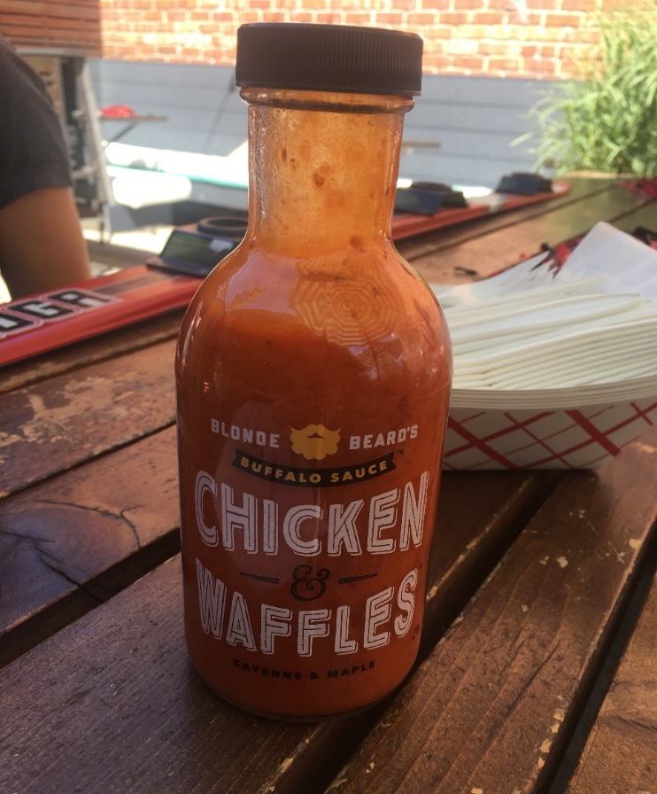
Best Practices: Venue
Build an ongoing relationship with your venue
Host events at your game watching party venue throughout the year
Work with management to make a great game watching party experience for guests and staff
Have a pre-season and post-season meeting with the venue to share feedback and ideas
Personalize game day traditions
Thank the staff!
Alumni.uga.edu

Slide 7
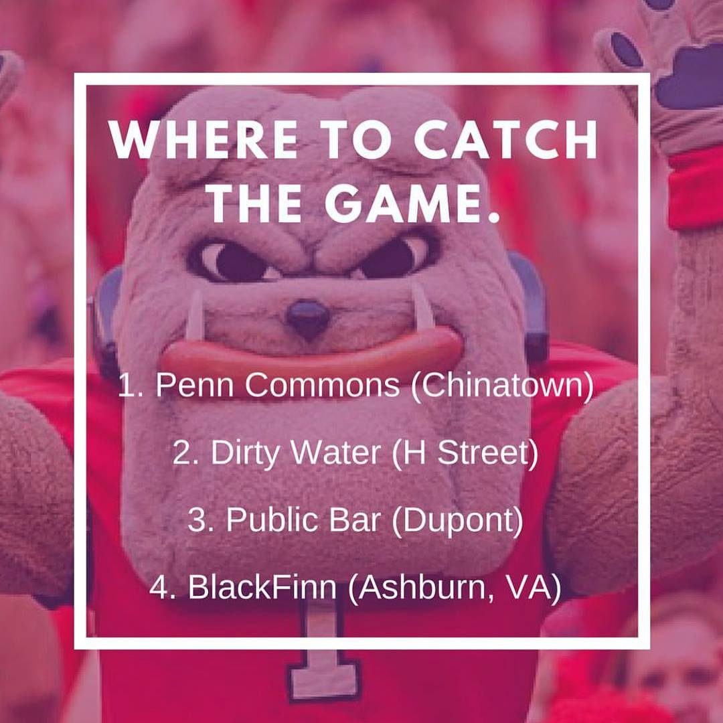
“Should we add another location?”
Consider multiple locations when:
Game watching parties are consistently well-attended
You have a chapter area with several “hot spots”
You have a host for another location
Doing so will not negatively compete with your primary location
Different locations may cater to different demographics
Alumni.uga.edu

Slide 8
Best Practices: Communications
Turn your GWP form in on time!
Create each event on Facebook
Use your listserv weekly
Make a social media post before each game
Reposting UGA Athletics content is great for this
At the event, encourage attendees to keep in touch with the chapter through social media and the listserv
Share pictures on social media – show people what they’re missing!
Alumni.uga.edu

Slide 9
Best Practices: Communications
Have fun on social media! Show off the personality of your chapter.
Alumni.uga.edu

Slide 10
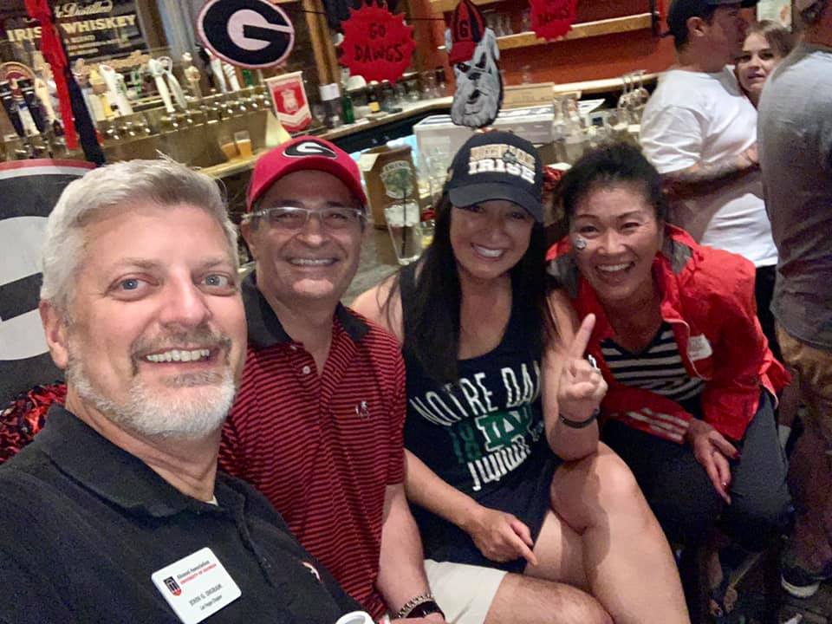
Best Practices: Event Experience
Be a host – say “hello” to new faces and interact with as many guests as possible! Make everyone feel like they’re among friends.
Consider a welcome table for larger groups
Make the most of your supplies
Setting up before the game starts
“Ration” supplies for the season
Ask staff if you need additional supplies
Decorate your space with purchased items from the Bookstore
Alumni.uga.edu

Slide 11
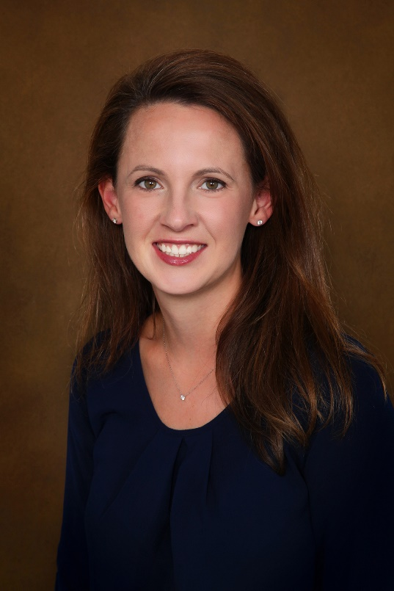
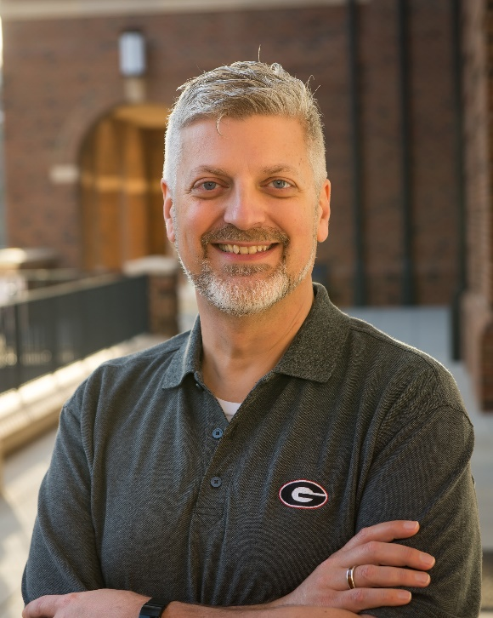
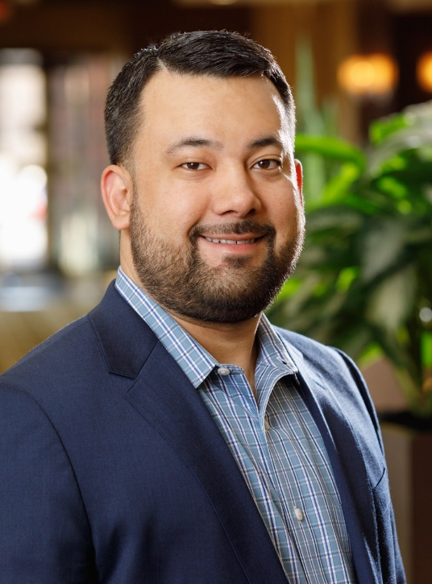
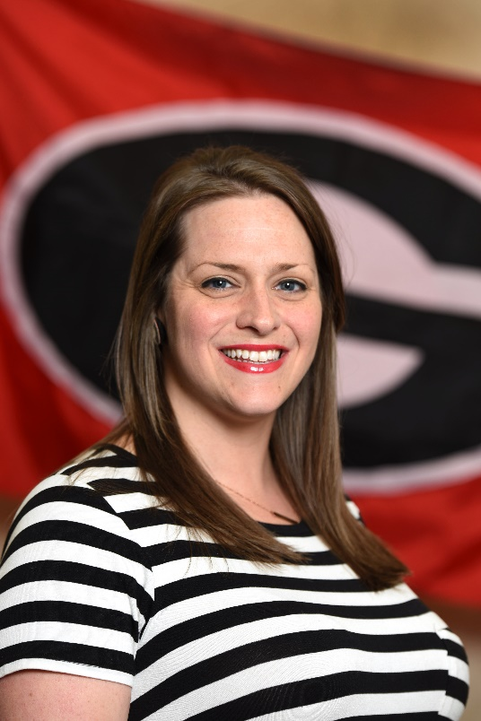
Game Watching Party Panel
Linda Fernekes
Colorado
John Ingram
Las Vegas
Tyler Anderson
Austin
Seela Jacobs
St. Louis
Alumni.uga.edu

