Slide 1
What’s Happening at UGA: Additional Information to Know When Talking with Alumni
Meredith Johnson – Executive Director, Office of Alumni Relations
Frances Beusse – Senior Director of Alumni Outreach

Slide 2
What is the most random question you’ve been asked as a volunteer for the University of Georgia?
Notes:
? It’s okay not to know. Here’s some tidbits that you can know, so you have a few things to say, Oh yes, I know about that.

Slide 3
Discussions Points
During this Session we will discuss:
Role of the Office of Alumni Relations
3 Priorities of UGA’s Strategic Plan
Random Questions from Alumni

Slide 4
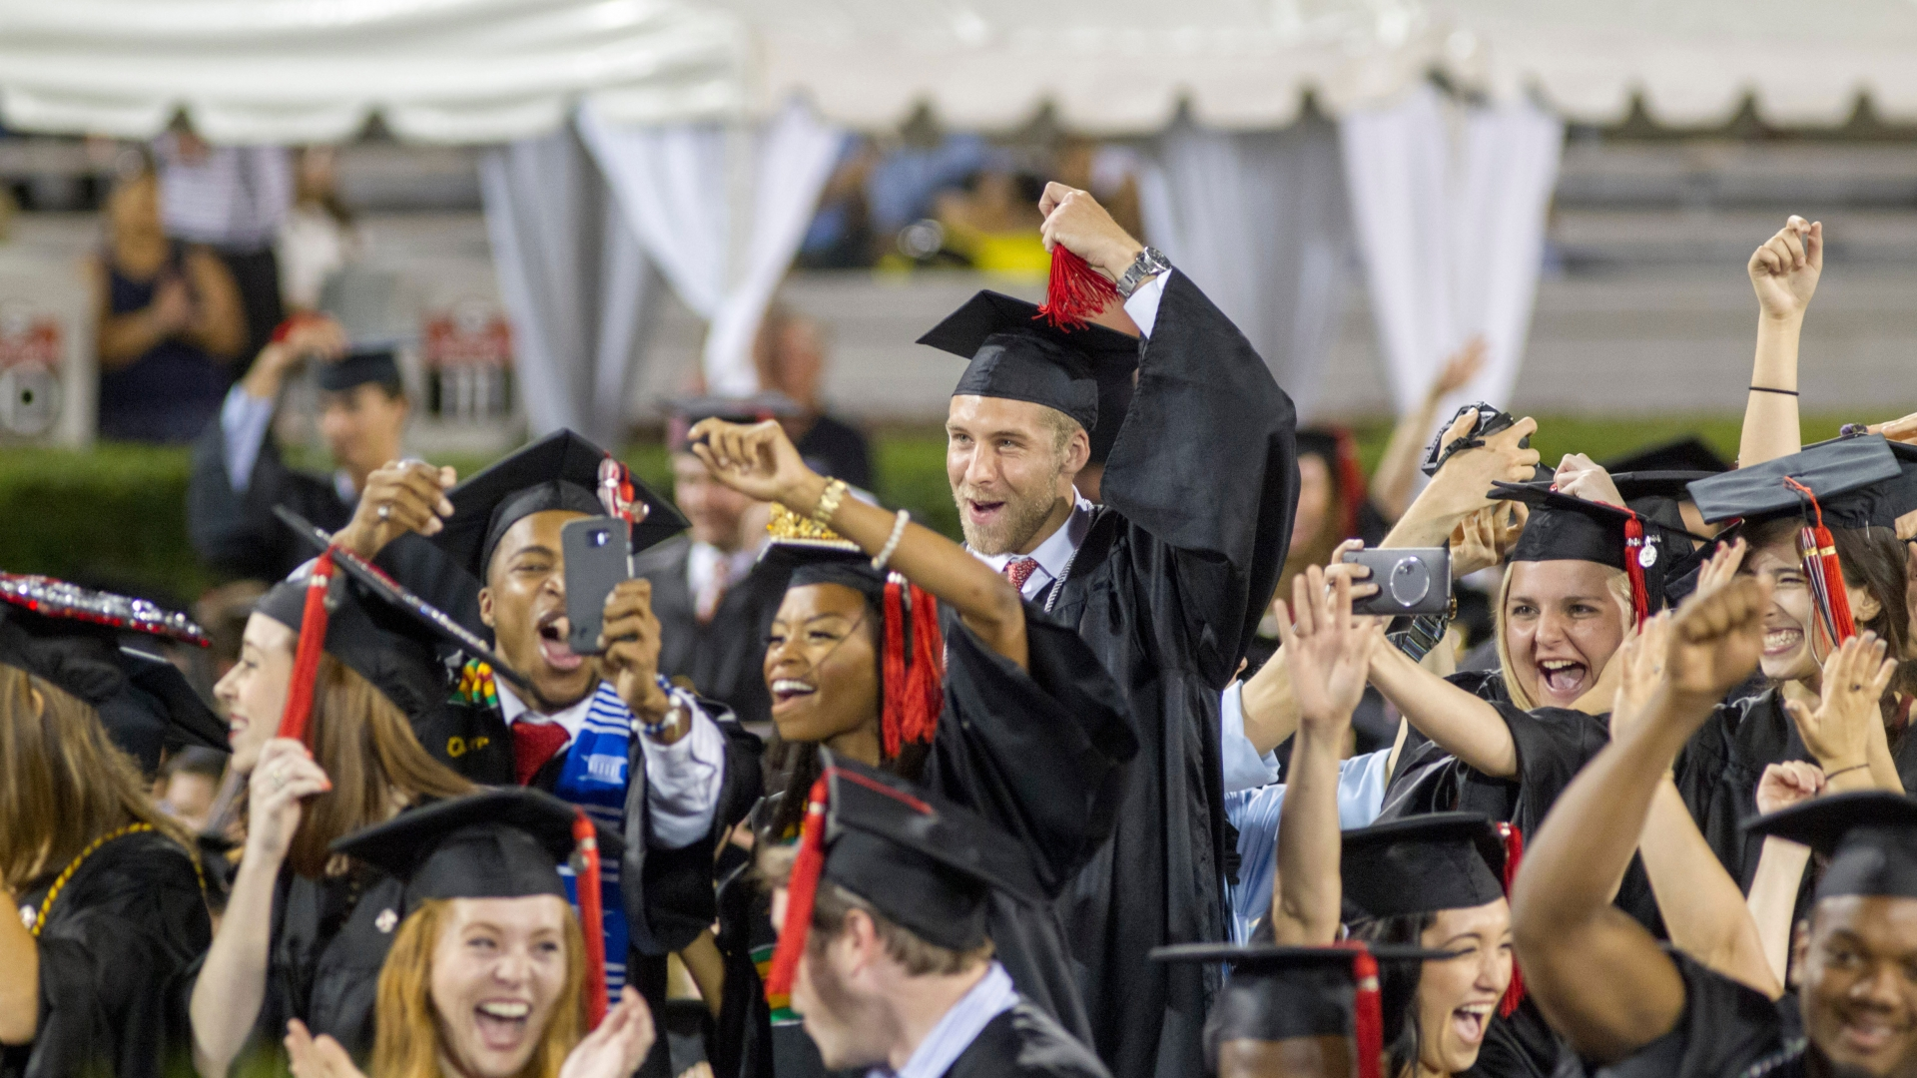
What is the Goal?
For all UGA Graduates to
become advocates of UGA
Notes:
We are here to make sure 327,000 are connected to the Universty. We do it through a lot of different ways, but y’all are a part of that.
The need to have all of the answers. WE are never going to have the answers, but here are some things that are helpful to know about for when you get some of the random questions, like you just wrote down.

Slide 7
2025 Strategic Plan
Promote Academic Excellence in Teaching and Learning
Growing Research, Innovation & Entrepreneurship
Strengthening Partnerships with Communities Across Georgia and Around the World
Notes:
State of the University Address - These are things happening on campus. We are going to touch on points that all lead back to this.

Slide 8
Promote Academic Excellence in Teaching and Learning
Promote Academic access and success for all students with particular consideration for underrepresented, rural, first-generation, and other underserved students.
Scholarships & Tuition
Notes:
The scholarships we are raising, and educating alumni about this need. What scholarship opportunities are we up against?
*how can you use the information we just went over, as a volunteer?
How Tuition Works
Tuition. In state tuition would cost. Zell and Hope.
Zell/Hope does not cover room, board.

Slide 10
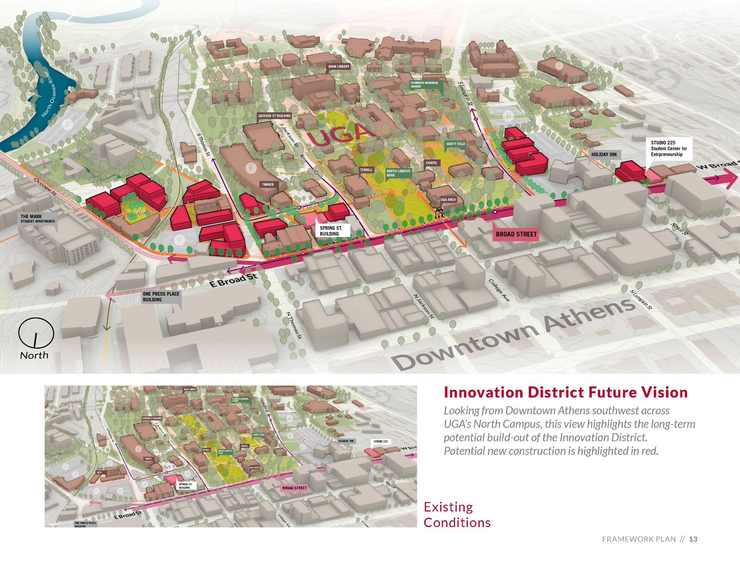
Growing Research, Innovation & Entrepreneurship
Notes:
Studio 225 as the new home of our thriving Student Entrepreneurship program
Spring Street Building to support our growing pipeline of faculty startups and expand project-based learning and industry engagement. Earlier this year announced $3.5 million gift from The Delta Air Lines Foundation
Innovate U will launch this summer as a weeklong residential program for rising high school students in the Clarke County School District.

Slide 11
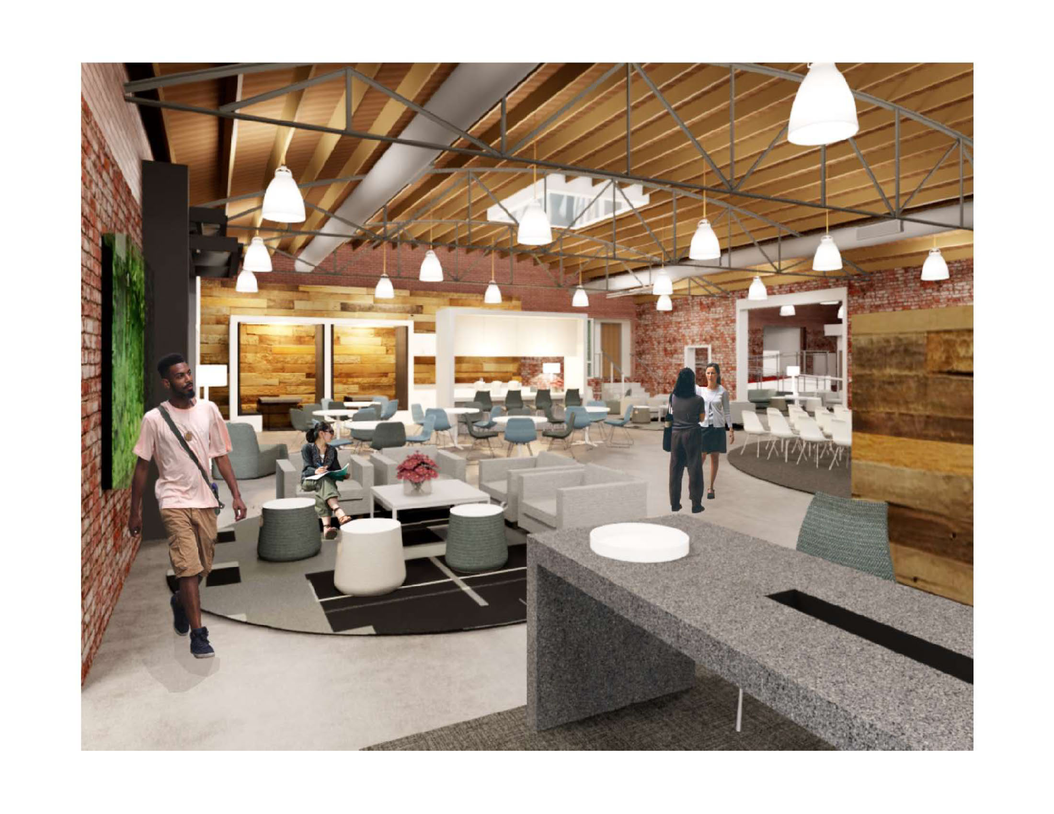
Growing Research, Innovation & Entrepreneurship
Notes:
Studio 225 as the new home of our thriving Student Entrepreneurship program
Spring Street Building to support our growing pipeline of faculty startups and expand project-based learning and industry engagement. Earlier this year announced $3.5 million gift from The Delta Air Lines Foundation
Innovate U will launch this summer as a weeklong residential program for rising high school students in the Clarke County School District.

Slide 13
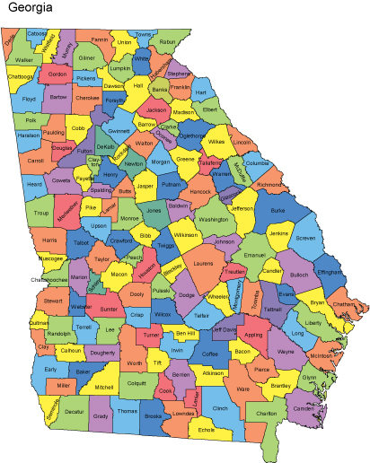
Strengthening Partnerships
Communities Across Georgia
Archway Partnership
Extension Agents
Tifton, Griffin & Gwinnett
Around the World
Washington, DC
Cortona, Italy
Oxford, England
Notes:
UGA is a national leader in university outreach with faculty, staff and students in all of UGA’s schools and colleges contributing to Georgia’s short- and long-term prosperity. In addition, eight Public Service and Outreach units focus specifically on serving Georgia:
Archway Partnership
Carl Vinson Institute of Government
J.W. Fanning Institute for Leadership Development
Marine Extension and Georgia Sea Grant
Office of Service-Learning
Small Business Development Center
State Botanical Garden of Georgia
UGA Center for Continuing Education & Hotel

