Slide 1
Affinity Programming in Your Chapter
From ‘what is it?’ to ‘we’ve got that!’
Realenn Watters
Associate Director of Outreach
Alumni Relations
Notes:
Set the tone that this is a safe space and open for folks to ask any question without judgement. Don’t wait until the end, feel welcome to ask questions as you think of them!

Slide 2
What IS an ‘affinity rep’?
Notes:
Ask group what their thoughts are… what do they think this position is? Before that, ask if there are any representatives or chapter who have reps in the room – don’t answer this question… yet

Slide 3
What is an affinity representative?
Member of chapter leadership board who actively represents the mission and goals of a particular affinity or identity group.
Also includes identity groups popular for a local chapter area
Not able to support affinity councils outside of Atlanta, however, affinity programming is important for university engagement
Also helps not to segment out smaller affinity populations – more inclusive for more impact
Includes but not limited to –
Black Alumni
Women of UGA
Young Alumni
LGBTQIA+
Veterans
Notes:
1. Make sure events are inclusive, and 2. propose events specifically for affinity groups.

Slide 4
Why would we want one…
or more?
Notes:
Based on the previous discussion – why would a chapter want this position? If you are loking around at your events and are seeing the same people, in the same demographics… there’s work to do.

Slide 5
Benefits of having an affinity rep:
Here are a few to get us started:
Reaching new groups of alumni for engagement
Different leadership perspectives
Fresh volunteers in the network
Enhanced/Enriched/More robust chapter programming
______________________(feel free to share!)

Slide 6
How do we even do this?
Notes:
What are those steps. How do we have the conversation about affinity reps and how many we can sustain?

Slide 7
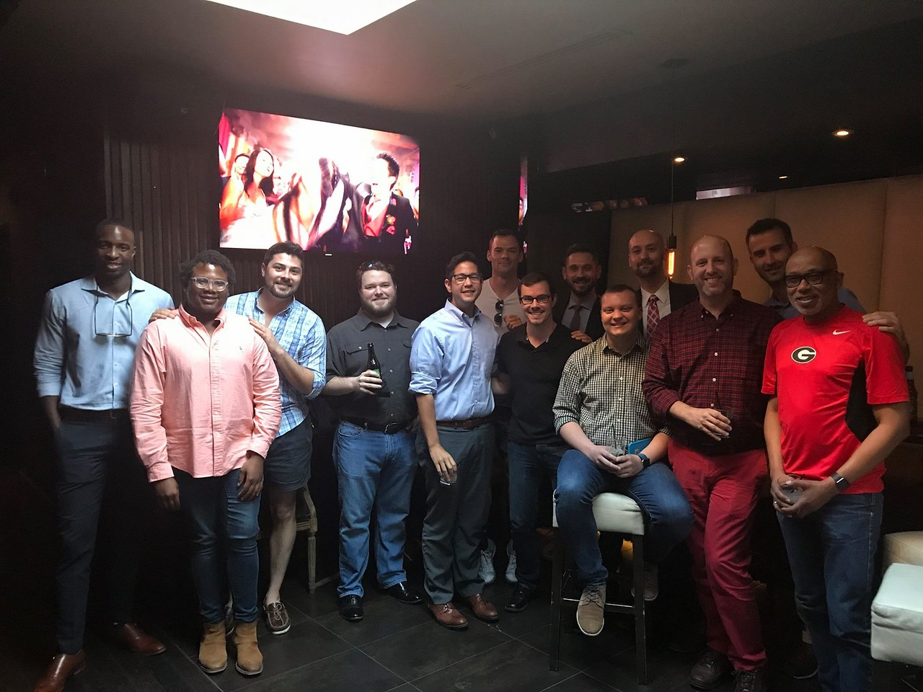
Cape NO Fear
Talk it out
Must have open and honest conversation regarding affinity programming all board members are not familiar with
What does everyone see as pros and cons?
Treat it like Tapas
Don’t eat the whole elephant. Don’t feel pressured to have 4 affinity representatives! Start small and start with one AWESOME event.
Turn it into Family
Objective is to include affinity programming in with chapter programs

Slide 8
Next Steps
Request a heat map/demographics of alumni in area to ascertain what affinity programming is a best fit for the chapter-
Gender, race/ethnicity, age breakdown, etc.
For non-recorded UGA groups, the chapter board and prospective affinity rep must agree the representation is mutually beneficial for the chapter and group.
Chapter board agrees/approves addition of position
Representative proposes an event for affinity committee to take lead on and/or take lead on one established chapter event; sharing how this affinity group can help improve outcomes.
Affinity programming follows the same established chapter rules and timeline requirements for planning.
Notes:
Note: Events, can be submitted to the chapters office through grant funding request, for some of the more involved programs. Chapters have a certain number and amount they can request each year.

Slide 9
How does each chapter officer support?
Notes:
Okay you have this person on the chapter board – what is needed from the other officers? Important that it doesn’t become a “them” or “they do” thing. Every officer and program needs support.

Slide 10
Event Execution
All chapter leaders should be invested in affinity event success:
Share the event
Attend the event
Staff the event
Welcome/greet attendees (and connect with them during the event)
Send post-event follow up to attendees
Invite them to the next event
Encourage them to join chapter communication tools (listserv, follow social media)
Notes:
All communication and networking and connections HAVE to be genuine in order for this to work successfully.

Slide 11
What should we do?
Notes:
Have them share program/event examples.

Slide 12
Program Examples
Get the creative juices flowing!
Women’s history month event
Desegregation anniversary event
Networking
Dinner with a dozen dawgs
Women of UGA lunch groups
Pride Nights (LGBTQIA+)
Mentorship Mondays (on a smaller/quarterly scale)
Welcome to the city
Book Club (Charlotte)
Lunar New Year Celebration
Diwali Dinner
Think about local events you can join in on!

Slide 13
Who do we talk to?
Notes:
Who is chapter and this particular officer communicating with? – ask group

Slide 14
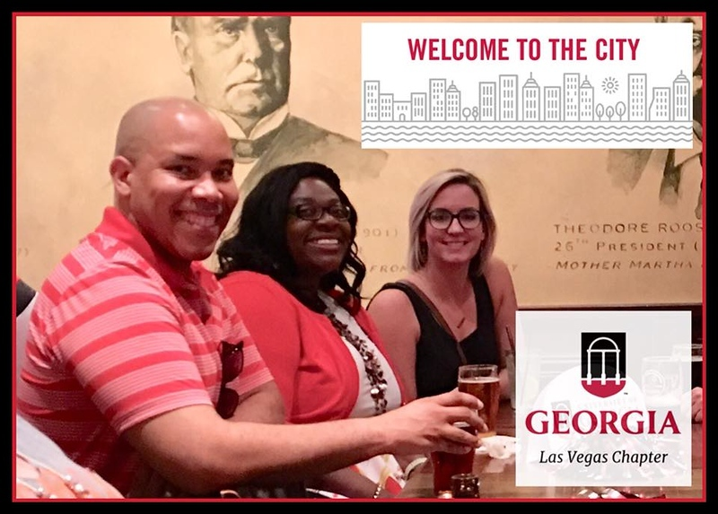
Communication is Key!
Internally
Chapter board should be communicating throughout ALL event planning timelines.
‘Associationally’
Communicate regularly with affinity council leadership via listserv
Stay current on initiatives, marketing campaigns, signature events, fundraising goals, etc.
Will be connected to other chapter level affinity representatives for additional support.
Locally/Externally
Ensure that chapter volunteers are equipped to share the story and provide guidance to new and established attendees.

Slide 15
That’s All Folks!
Realenn Watters
Associate Director of Outreach
Alumni Relations
rwatters@uga.edu
404.814.8820
Notes:
Open floor for full q&a.

