Slide 4
CHAPTER & COUNCIL AWARDS

Slide 5
Digital Award Badges!

Slide 6
the
COUNCIL EVENT
OF THE YEAR
award

Slide 7
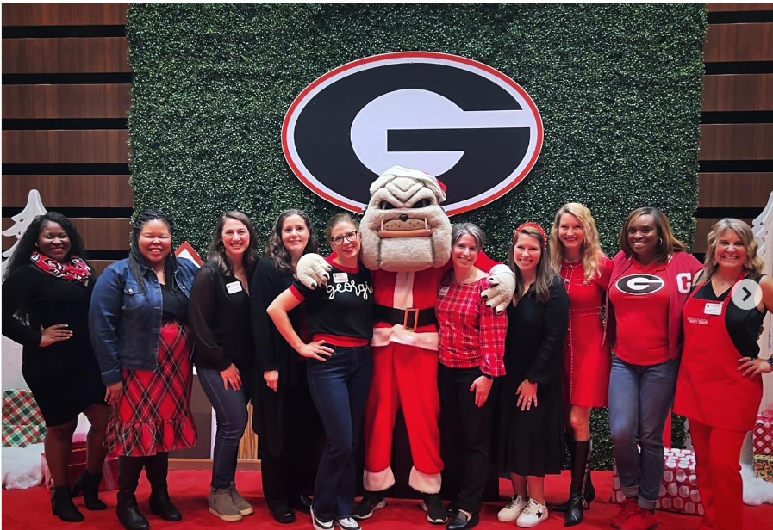
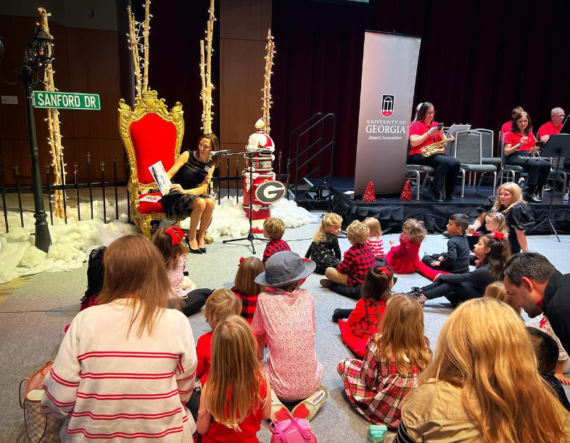
Women of UGA Council
2023 Cookies & Cocoa with Hairy Dawg

Slide 8
the
COUNCIL VOLUNTEER
OF THE YEAR
award

Slide 9
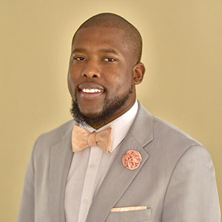
Rodd Cargill (BS ‘10)
Black Alumni Leadership Council

Slide 10
the
COUNCIL VOLUNTEER
OF THE YEAR
award

Slide 11
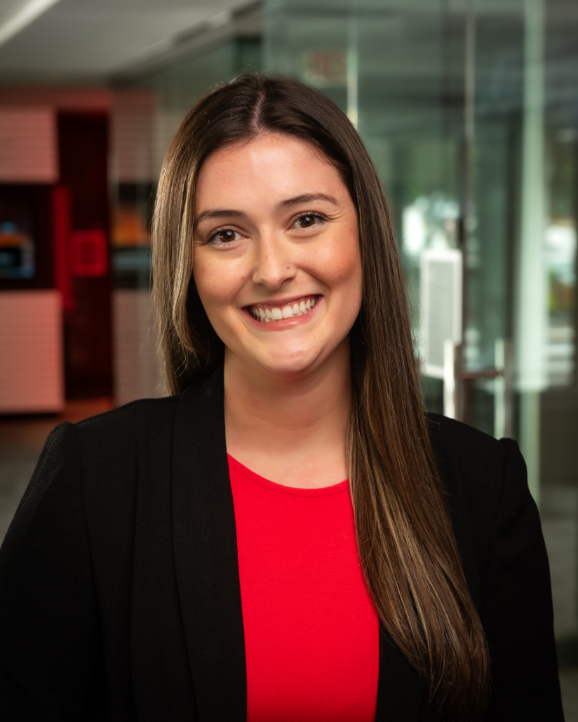
Melissa Crane (BBA ‘18, MA '19)
Young Alumni Leadership Council

Slide 12
the
COUNCIL VOLUNTEER
OF THE YEAR
award

Slide 13
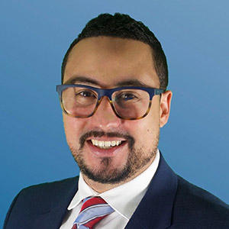
Will Perez(BBA ‘21)
Latino Alumni Council

Slide 14
the
COUNCIL
NEW MEMBER
OF THE YEAR
award

Slide 15
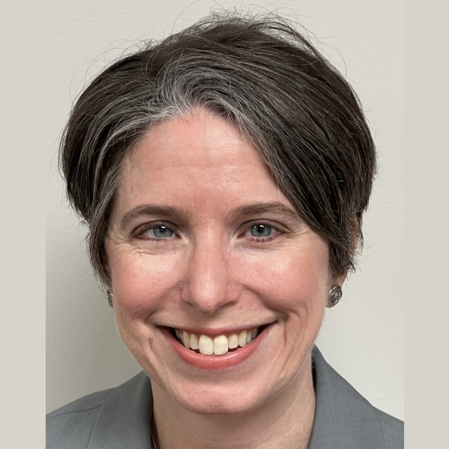
Debbie Durrence
Women of UGA Leadership Council

Slide 16
the
COUNCIL
OF THE YEAR
award

Slide 17
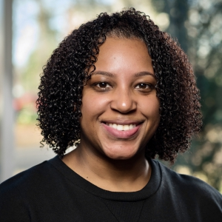
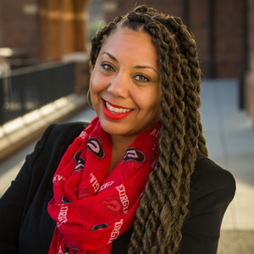
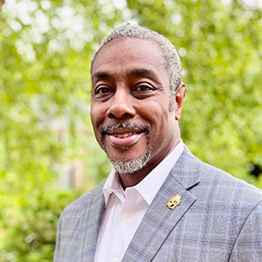
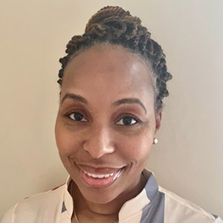
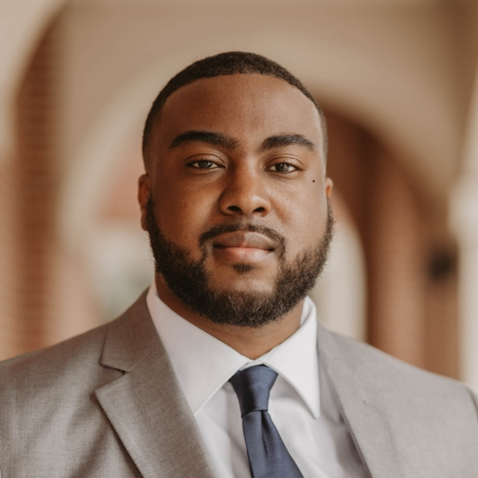
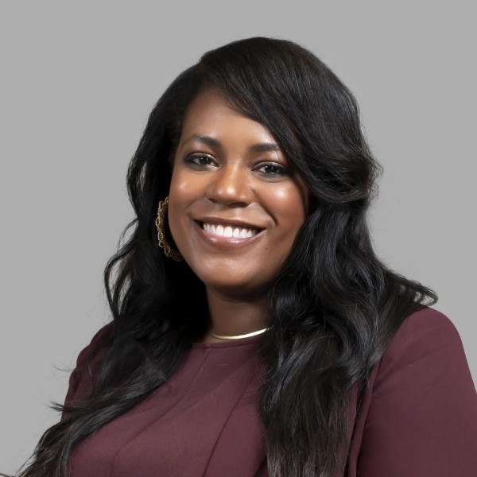
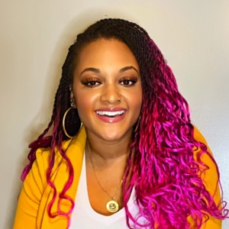
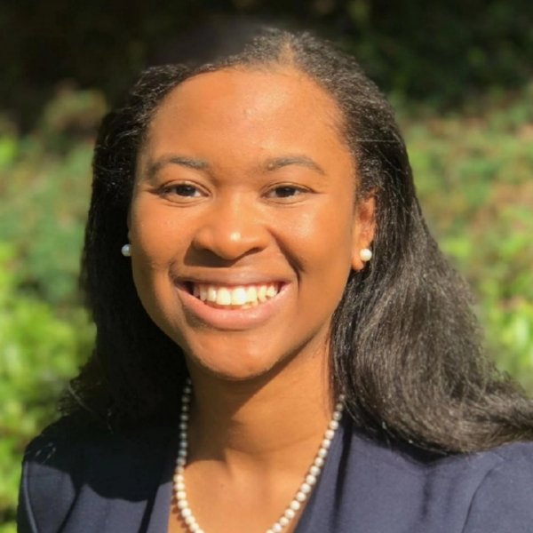
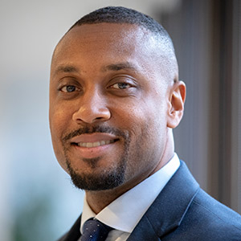
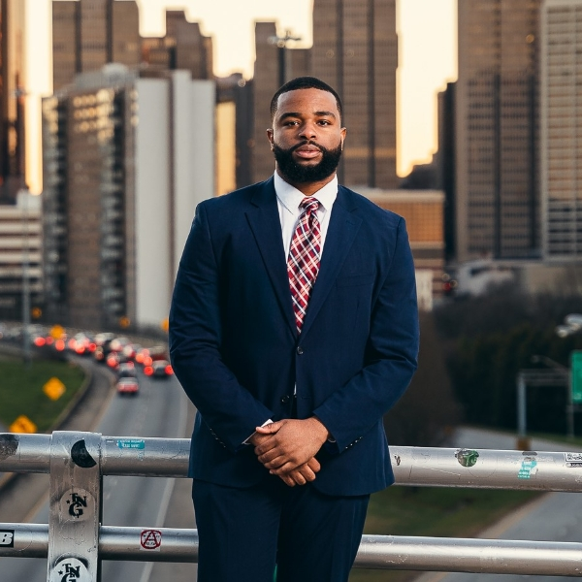
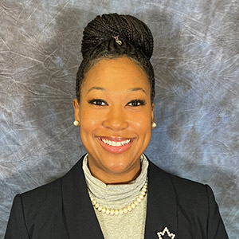
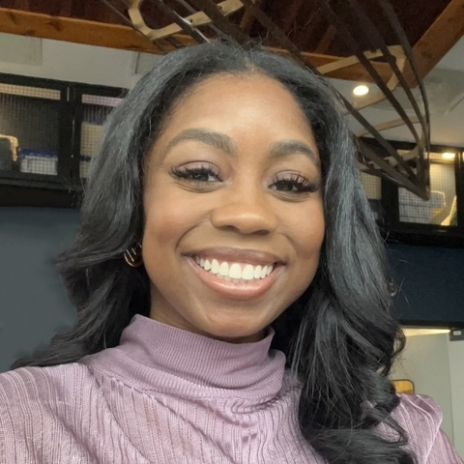
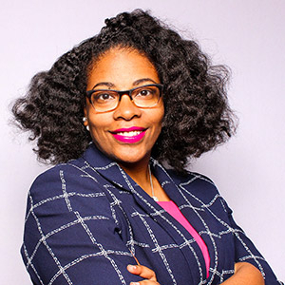
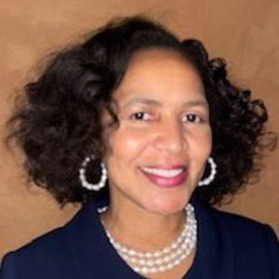
Black Alumni Leadership Council

Slide 18
the
CHAPTER EVENT
OF THE YEAR
award

Slide 19
New York City Chapter
"Coast-to-Coast“
June Pride Month Programming

Slide 20
the
CHAPTER EVENT
OF THE YEAR
award

Slide 21
London Chapter
Wimbledon Tailgate

Slide 22
the
CHAPTER VOLUNTEER
OF THE YEAR
award

Slide 23
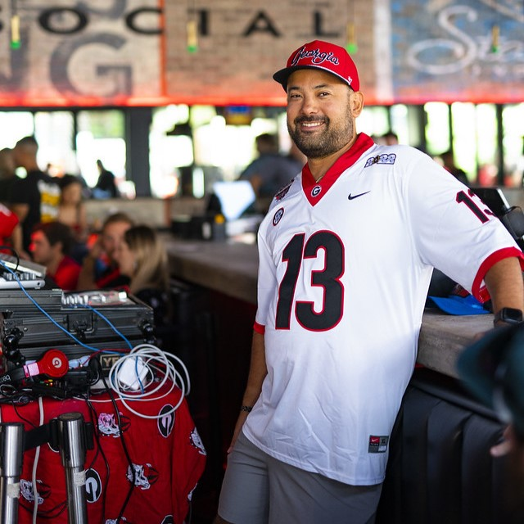
Tyler Anderson (BS ‘07)
Austin Chapter

Slide 24
the
CHAPTER VOLUNTEER
OF THE YEAR
award

Slide 25
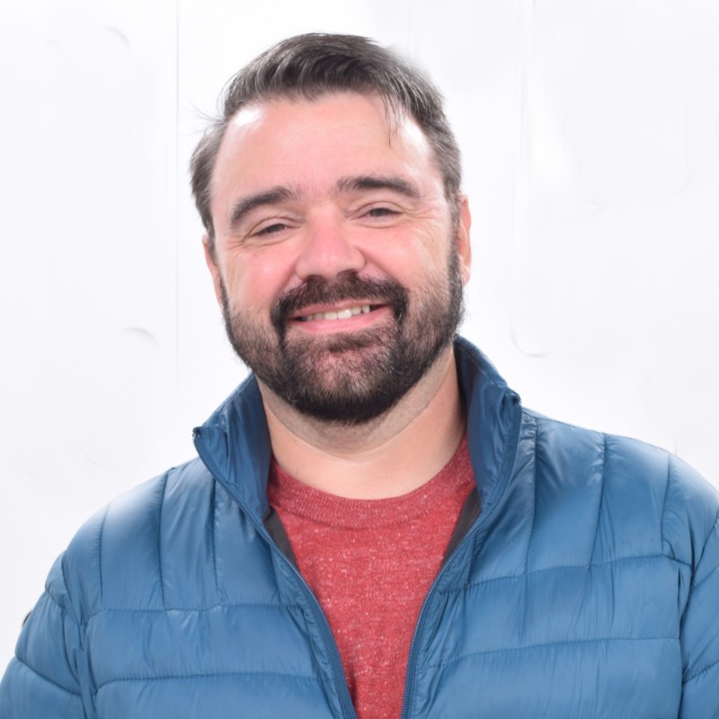
Christopher Sweat (BS '11)
Savannah Chapter

Slide 26
the
EMERGING CHAPTER OF
THE YEAR
award

Slide 27
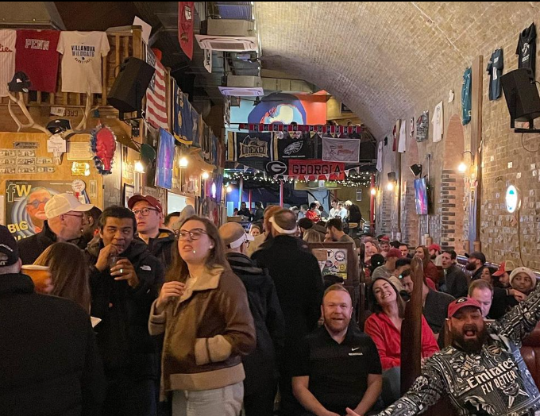
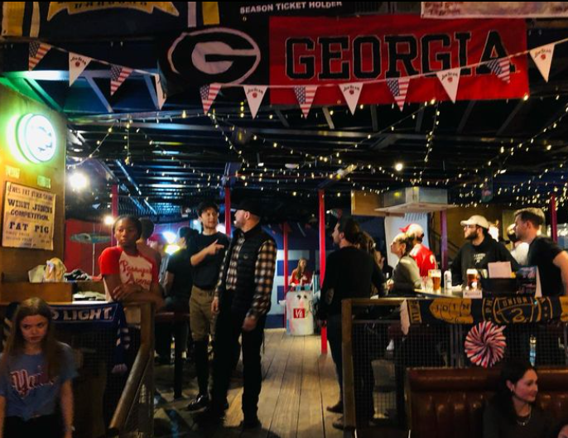
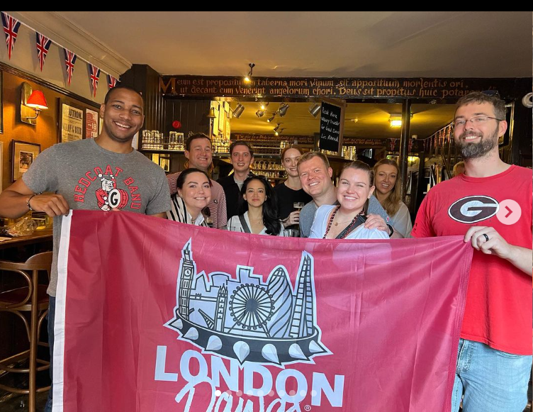
London Chapter
London Chapter Welcome to the City Pub Crawl

Slide 28
the
CHAPTER
OF THE YEAR
award

Slide 29
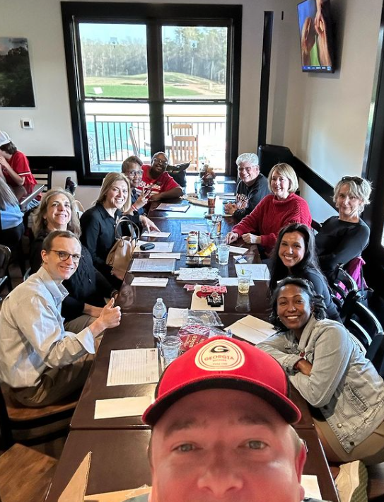
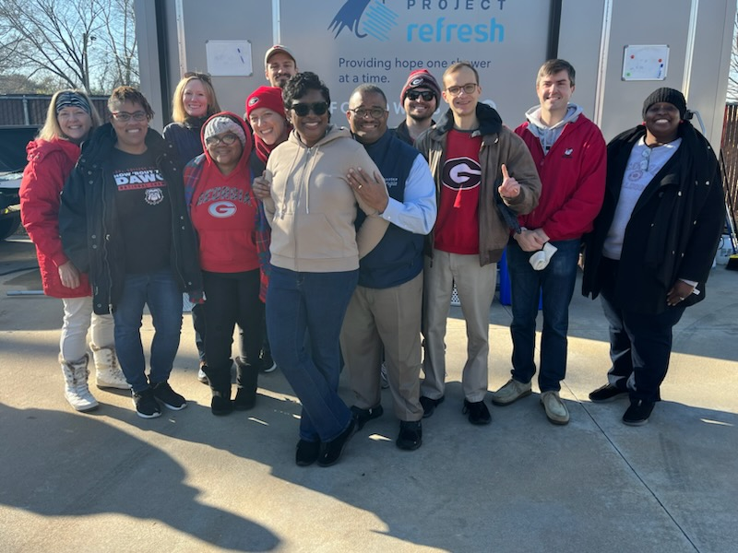
Augusta Chapter

Slide 30
Thank you,
alumni volunteers!

Slide 32
Next Up:
Enjoy the rest of the reception
You can go downtown, but you can’t stay here…
8:30 pm Shuttle Service to Hotel & Arch – Everyone out!
Notes:
edit

